Slide 1
Golden Gate Welcomes Your School!
Notes:
NatureBridge is excited to welcome you and your students to our Golden Gate campus for a hands-on, fun environmental science program!

Slide 2
About Us
NatureBridge connects young people to
the science and wonder of the natural world,
igniting self-discovery and inspiring stewardship of the planet.
Serves 35,000 students each year
Celebrates 50th Anniversary in 2022
Partners with National Park Service
Teaches in four NPS locations:
Golden Gate, Yosemite, Olympic and Prince William Forest

Slide 3
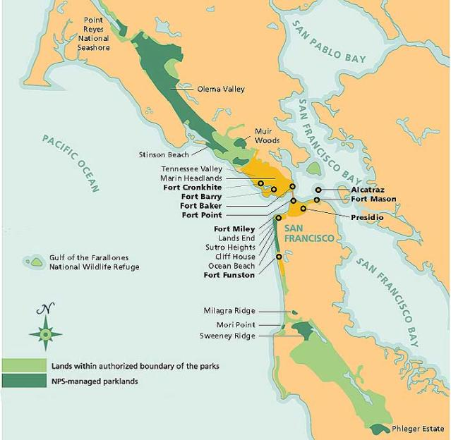
Where is NatureBridge located?
Golden Gate 1033 Fort Cronkhite Sausalito, CA
NatureBridge.org
Driving directions
Notes:
This gives a visualization of where we are located in relation to the broader Bay Area! The address is 1033 Fort Cronkhite, Sausalito, CA 94965

Slide 4
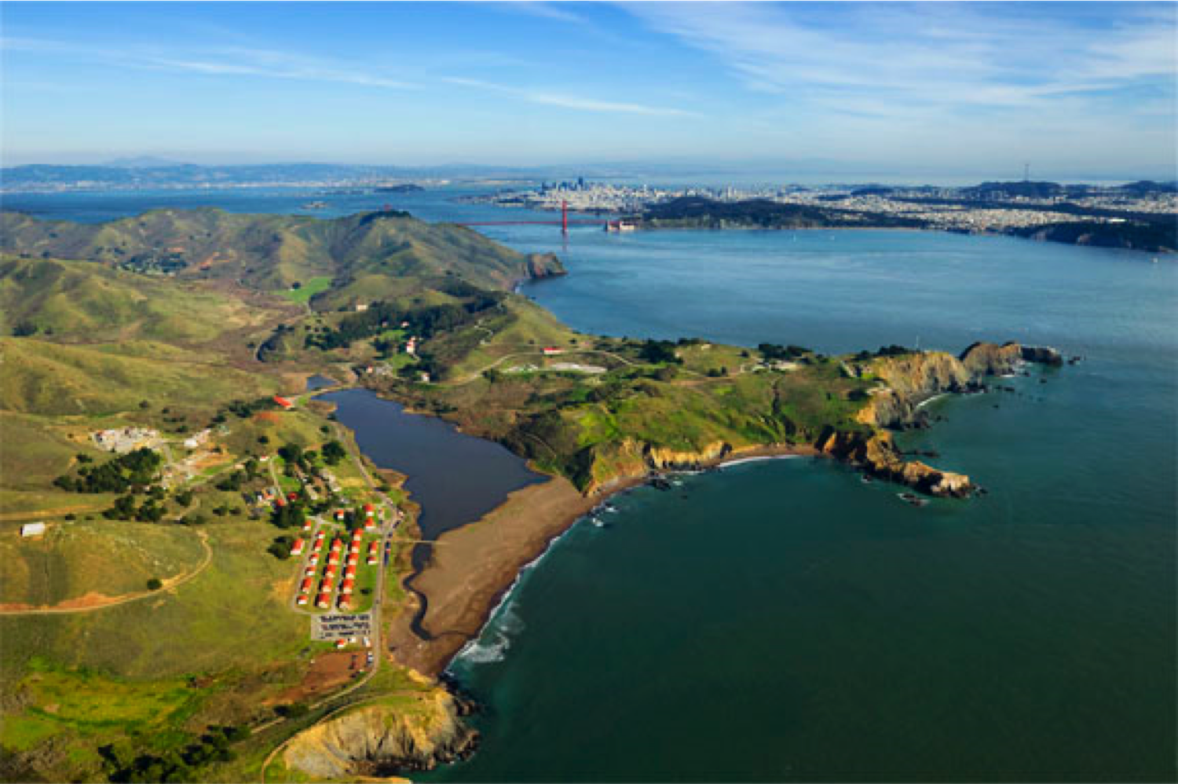
Beach Campus at Rodeo Beach
Located in the Marin Headlands
10 minutes north of Golden Gate Bridge
1033 Fort Cronkhite, Sausalito, CA
Notes:
This gives an aerial view of where we are located in relation to the Golden Gate Bridge and where we are located within the Golden Gate National Recreation Area. Beginning Fall 2022 NatureBridge will use the YMCA’s dormitories and dining hall at Point Bonita to provide lodging and meals for some of the schools participating in 3-day and 5-day programs. NatureBridge will continue to deliver the same educational experiences in the Headlands to all schools enrolled in Golden Gate’s Environmental Science Program whether they are assigned to Golden Gate’s traditional facilities at Fort Cronkhite for lodging and meals or to the Point Bonita YMCA facilities.

Slide 5
Bluff Campus at Point Bonita
Located in the Marin Headlands
10 minutes north of Golden Gate Bridge
981 Fort Barry, Sausalito, CA
Notes:
This gives an aerial view of where we are located in relation to the Golden Gate Bridge and where we are located within the Golden Gate National Recreation Area. Beginning Fall 2022 NatureBridge uses the YMCA’s dormitories and dining hall at Point Bonita to provide lodging and meals for some of the schools participating in 2-Night and 5-Night programs. NatureBridge will continue to deliver the same educational experiences to all schools enrolled in Golden Gate’s Environmental Science Program whether they are assigned to Golden Gate’s beach campus at Fort Cronkhite or to the bluff campus at Point Bonita.

Slide 6
Environmental Science Program Schedule
6:45 a.m. | Wake up (no earlier)
7:15 a.m. or 8 a.m. | Breakfast
9 a.m. | Morning Meeting
9 a.m. – 4 p.m. | Learning Groups explore the Headlands
4 p.m. | Activity time
5 p.m. or 6 p.m. | Dinner
7:10 p.m. | Evening Meeting
7:30 p.m. | Evening Program
8:30 p.m. | Get ready for bed
9:15 p.m. | Lights out
Notes:
With exception of arrival and departure days, here is what your daily schedule will look like!

Slide 7
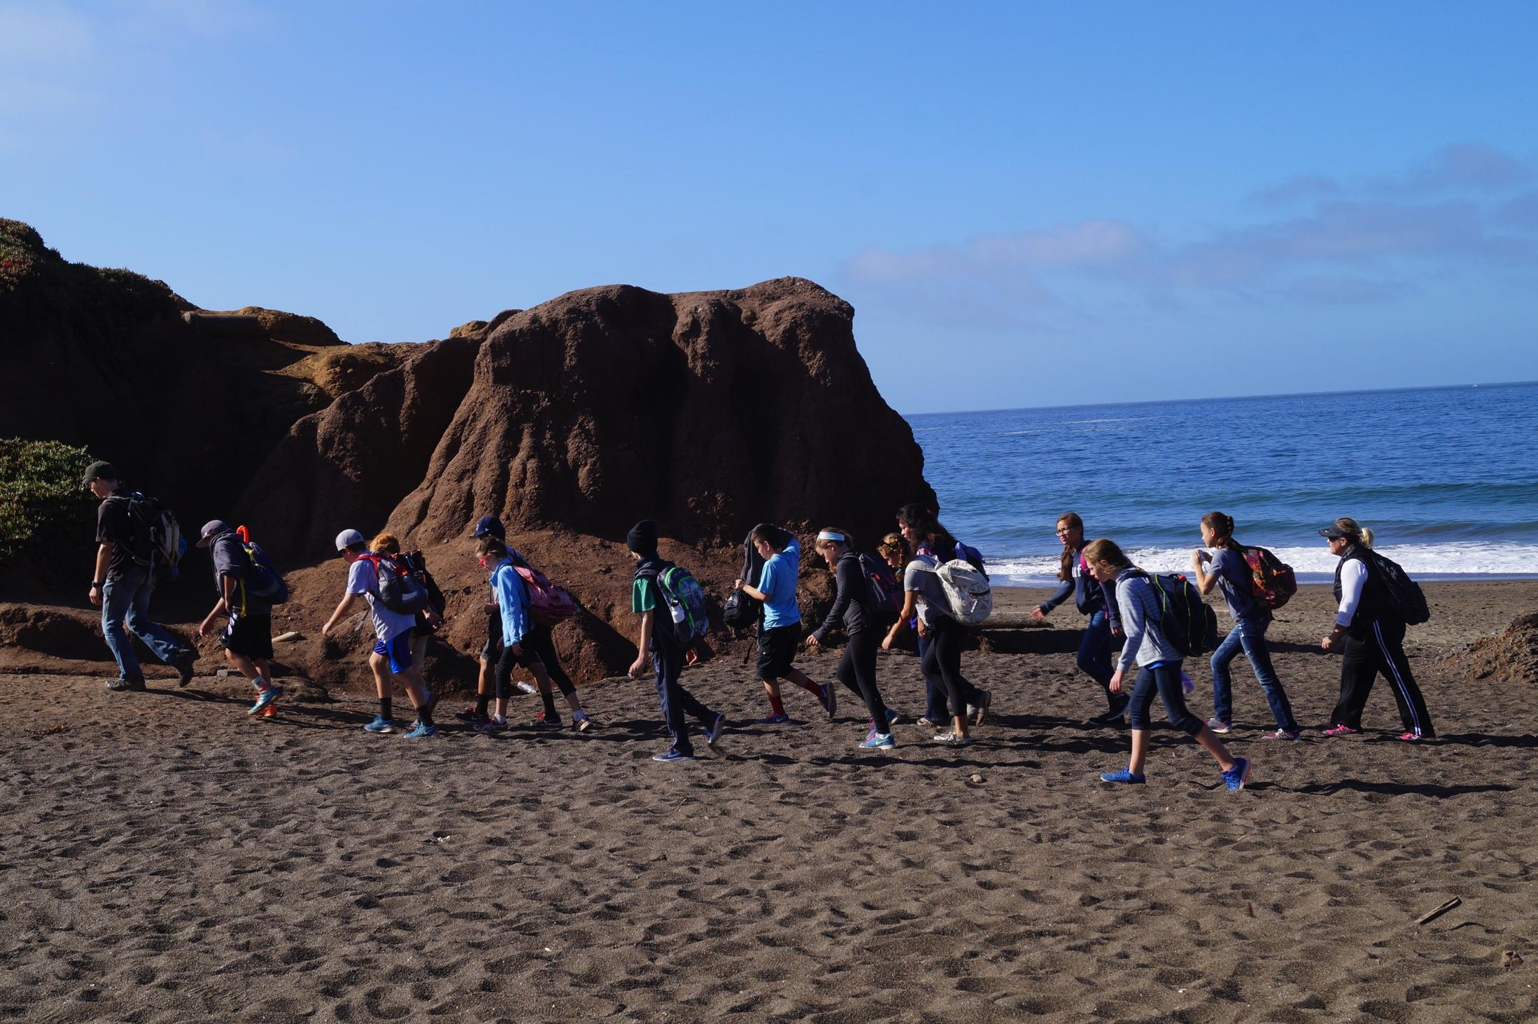
Learning Groups
Participants spend every day in the SAME
learning group:
1 NatureBridge educator
+
1 Adult school participant
+
16 Students or fewer
Notes:
Educators, students and chaperones are divided into smaller groups, so that everyone can be safe and have a better group experience. The maximum number of students per learning group is 16 for the 2022-23 school year.

Slide 8
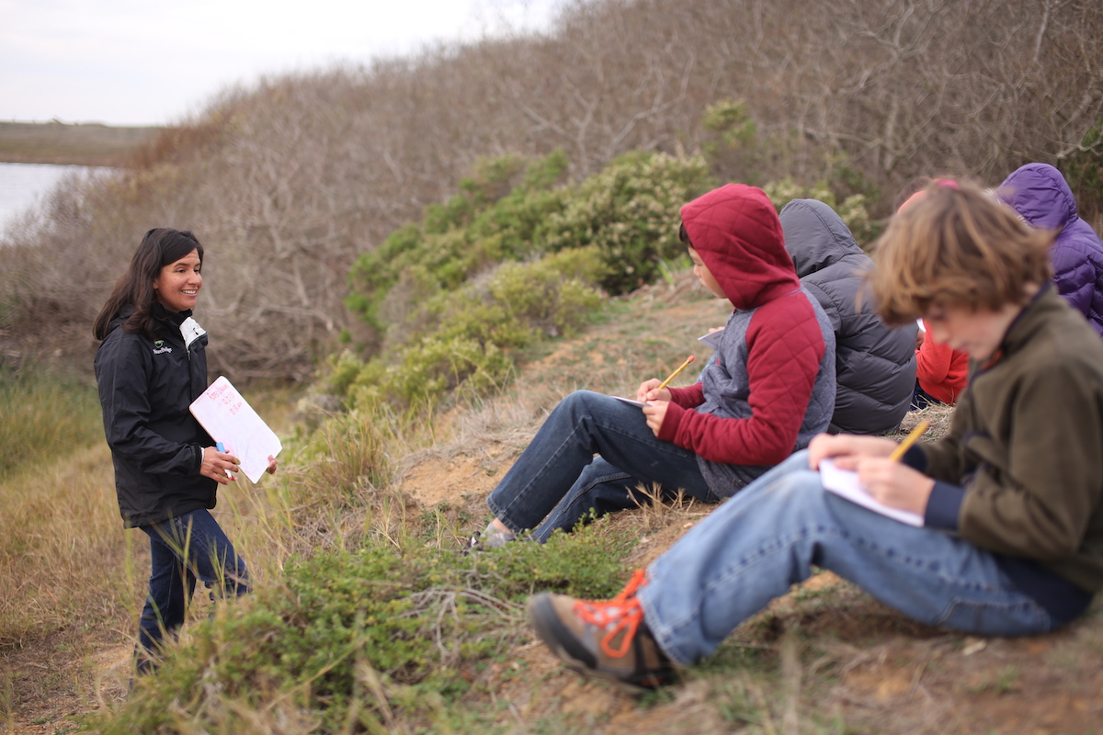
Areas of Study
Marine Ecology
Watersheds
Earth and Physical Sciences
Terrestrial Plants and Animals
Climate Change
Notes:
Beyond having a really great time, your students will be learning about one of these areas of study!
Marine Ecology: If your school chooses to study marine ecology, they may enter our marine lab where students can touch tidepool creatures!
Watershed: With the watershed focus, students can learn about water in California and possibly even scoop in the pond for critters.
Earth and Physical Sciences: The rocks in the Marin Headlands are incredible! Our beach is actually made up of rainbow rocks.
Terrestrial Plants and Animals: With this focus, students will learn about plants and animals in the area and how they interact with each other and affect us as people.
Climate change: With a climate change, students will learn how they can work together to make a difference in their home communities.

Slide 9
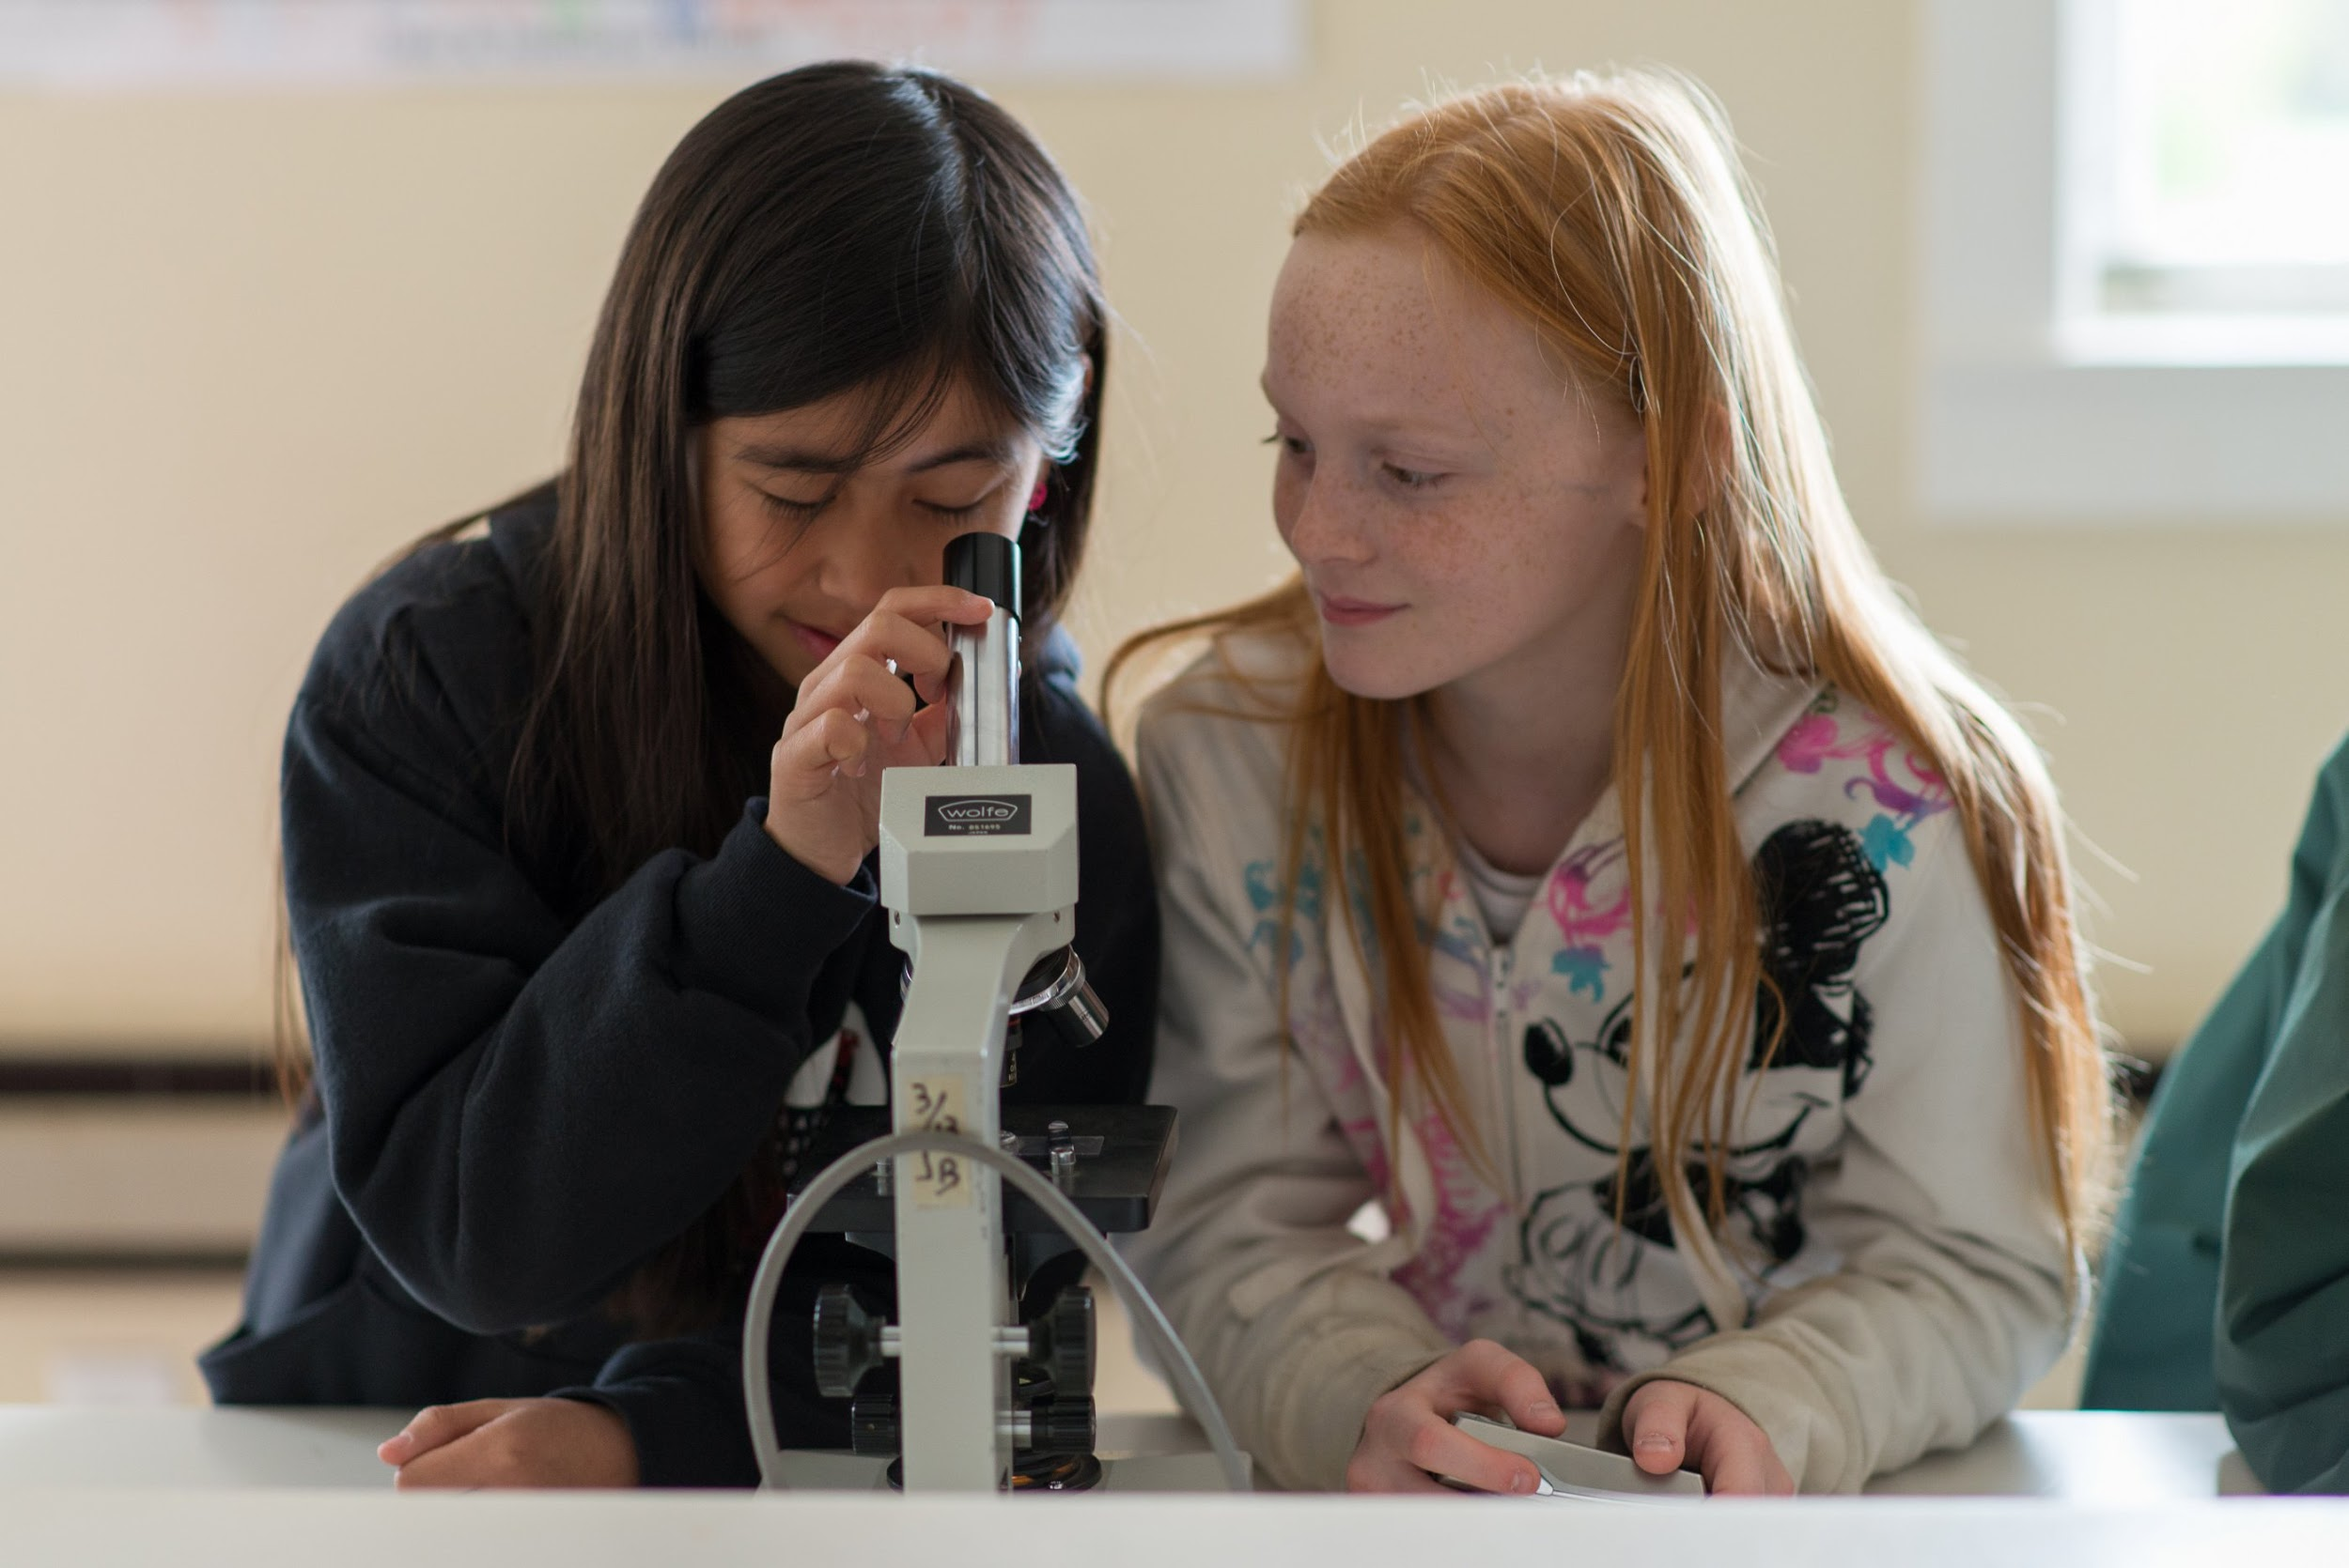
Environmental Science
Making observations
Asking research questions
Collecting data
Drawing conclusions
Notes:
As your students are learning about their area of study they will conduct hands-on science investigations, ask questions, collect data. Students develop critical thinking skills and apply learning in real time. Learning groups may have access to the NEW Climate Science lab, Skins & Skulls lab, and Marine Science lab as well as the nearby Marine Mammal Center. Access to these spaces depends on availability and hours of operation.

Slide 10
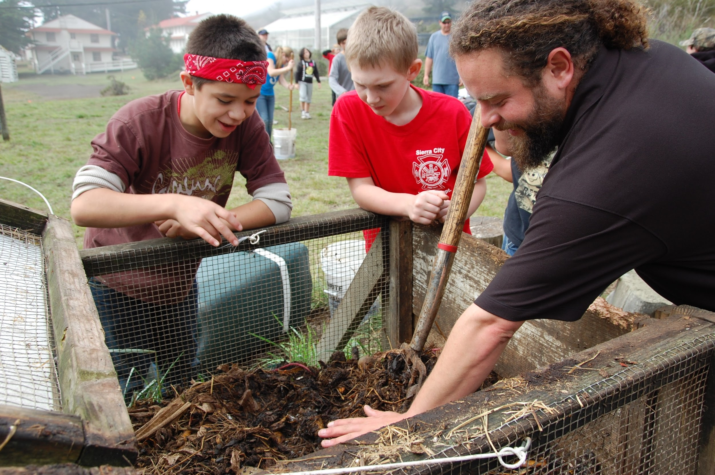
Stewardship
Help at the native plant nursery
Beach clean-up
Restore Habitats
Notes:
Students may participate in one of these stewardship activities and are empowered to take positive action to protect, conserve and improve the environment.

Slide 11
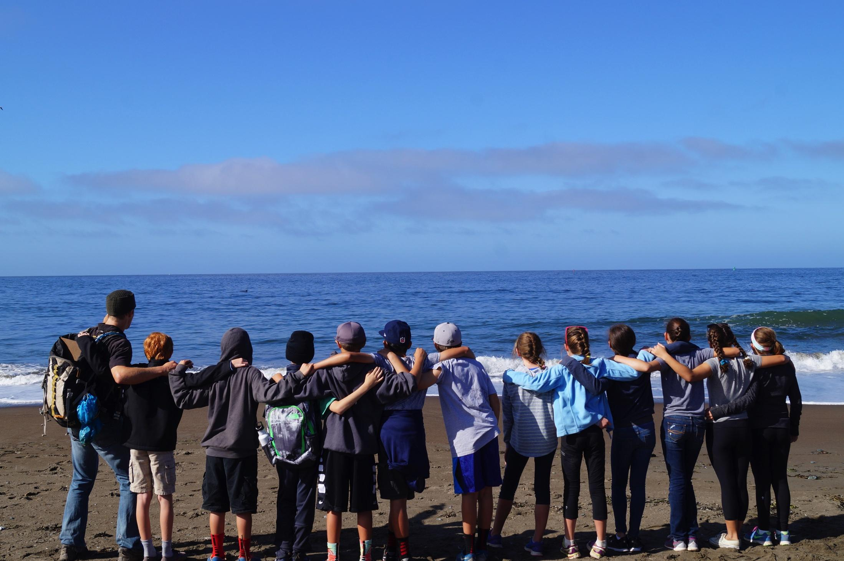
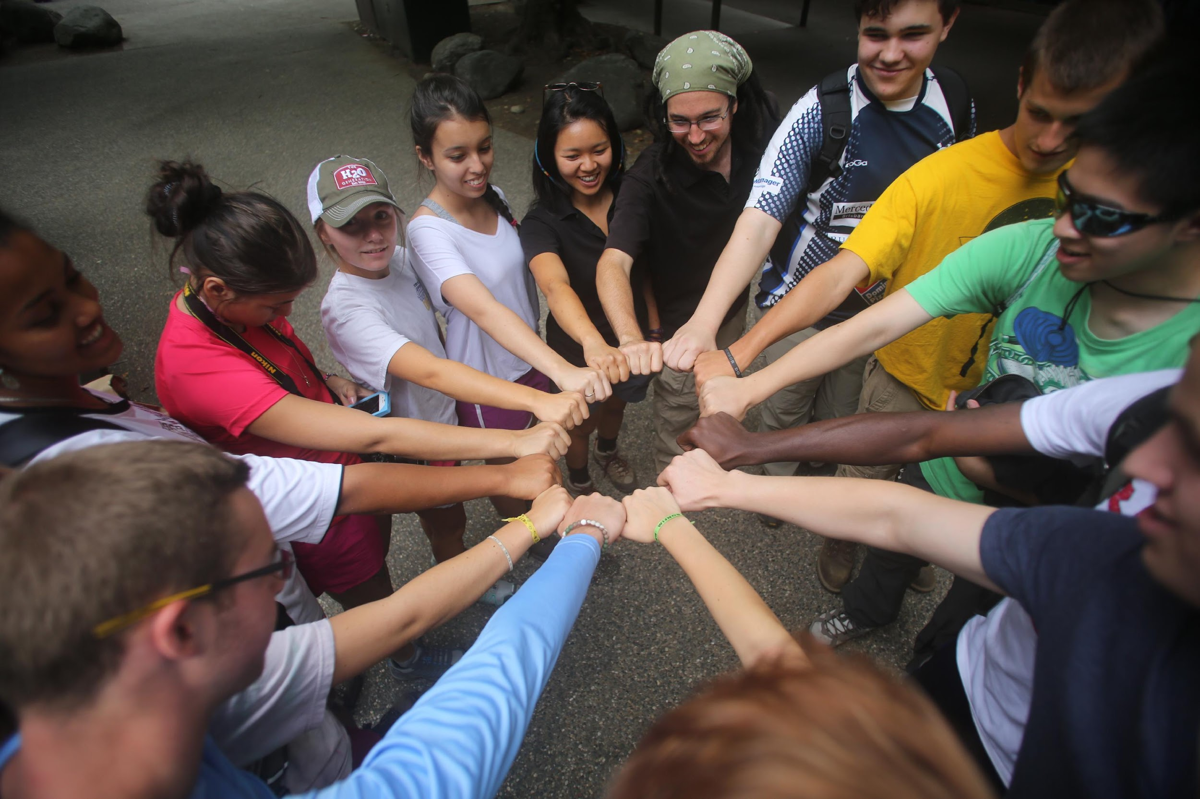
Personal Growth and Teambuilding
Notes:
For many students it will be their first away from home, but they’ll be creating lasting connections with their peers and teachers and renew their enthusiasm for learning!

Slide 12
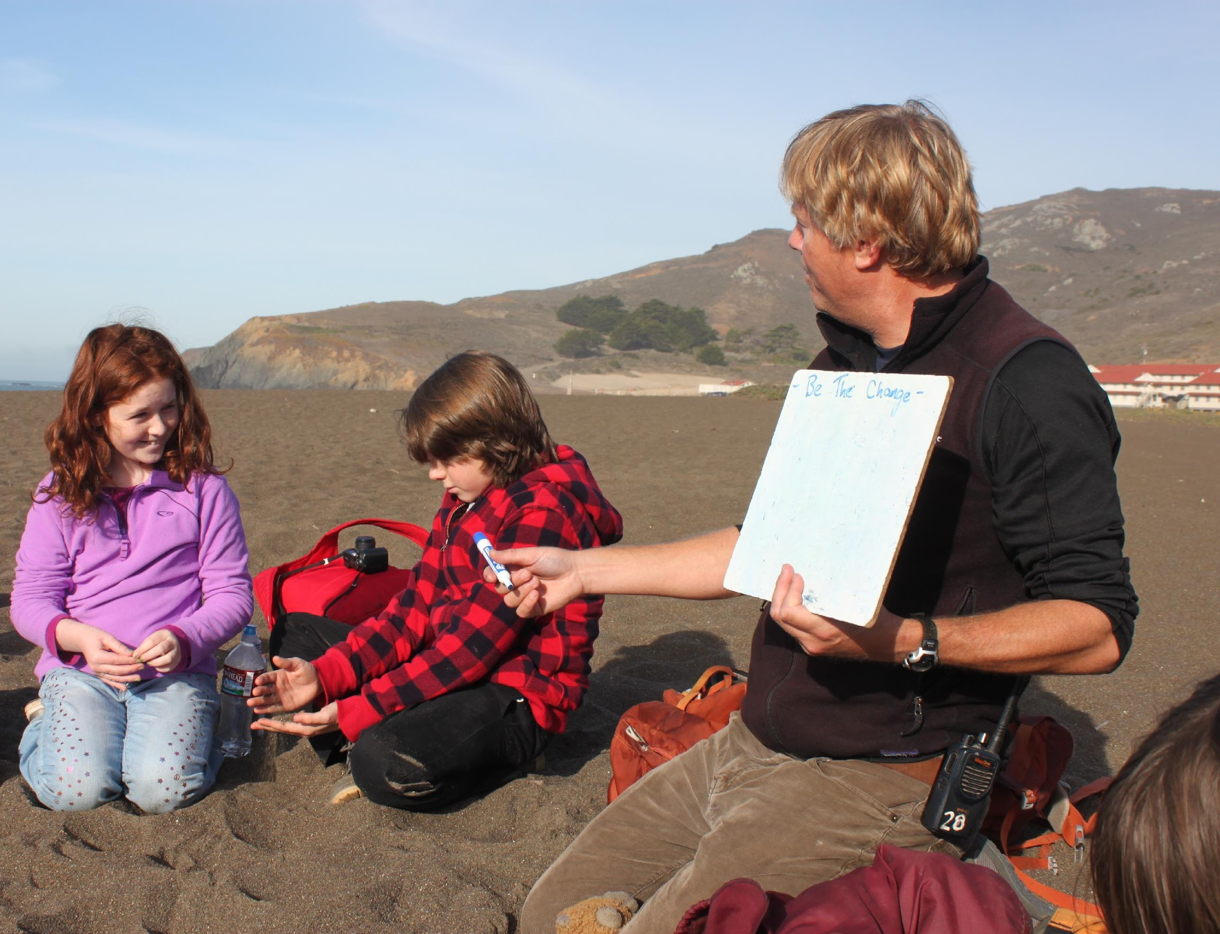
Environmental Science Educators
College grads or experienced employees
Outdoor instructors or group leaders
Passionate teachers with diverse experiences
Certificated Wilderness First Responders
Notes:
When your school arrives you’ll be greeted by our awesome educators who will give your students and adults an orientation. After the orientation, students and adults will move their things into the dorms and get ready for hiking and exploring the Headlands in their assigned Learning Groups!

Slide 13
Safety at NatureBridge
All educators:
Have First Aid and Wilderness First Responder certification
Carry a radio to connect with our team on campus
Our campus is:
Less than 10 minutes from the Sausalito Fire Station
Less than 30 minutes from several major hospitals
Emergency contact during business hours: (415) 332-5771
Emergency contact after business hours: Your group coordinator

Slide 14
COVID-19 Policies & Protocols
NatureBridge Health & Safety Plan (HSP)
Updated as needed to outline policies and protocols to
minimize the risk of communicable diseases
guide management if illness does occur
guide schools to screen and prepare participants prior to arrival
Notes:
This is a living documents which is updated as needed. NatureBridge staff will inform group coordinators when major changes have been made. Please review this prior to arrival day to be certain that you are well informed of these policies and protocols.

Slide 15
Chaperones
Chaperones are key to a successful program. They are:
Engaged participants – acting as “guides on the side”
Subtle disciplinarians
Attentive supervisors during activity time and overnight
Supportive of ALL students
Notes:
Here are a few things we ask of our chaperones! Are there any parents here who have been a chaperone in the past? Any tips? We also require parent chaperones to be in a DIFFERENT learning group from their children. And we require all adults to be assigned to a learning group, even if that adult is staying back on campus during the learning day to support a student participant. NatureBridge requires one PRIMARY chaperone per learning group of 16 students who stays with the SAME learning group throughout the program.

Slide 16
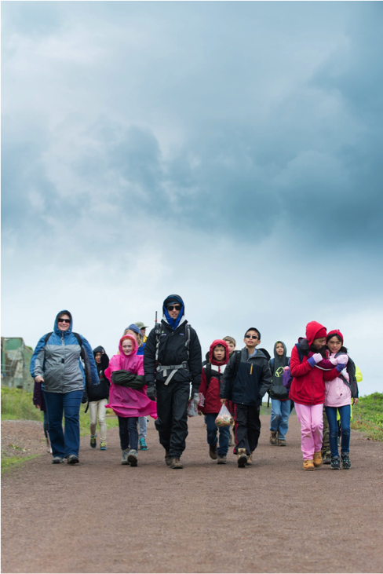
What to Wear
Marin Headlands weather
is unpredictable! Mornings can be foggy, and afternoons can be hot & sunny.
Dress in layers: jackets, hats and gloves
Bring an outer water/wind resistant layer: poncho or rain jacket.
Notes:
This group is well prepared for cool, windy or wet weather in the Marin Headlands! Carry your weather proof layers and warm layers in your day pack even if the day begins with sunshine!

Slide 17
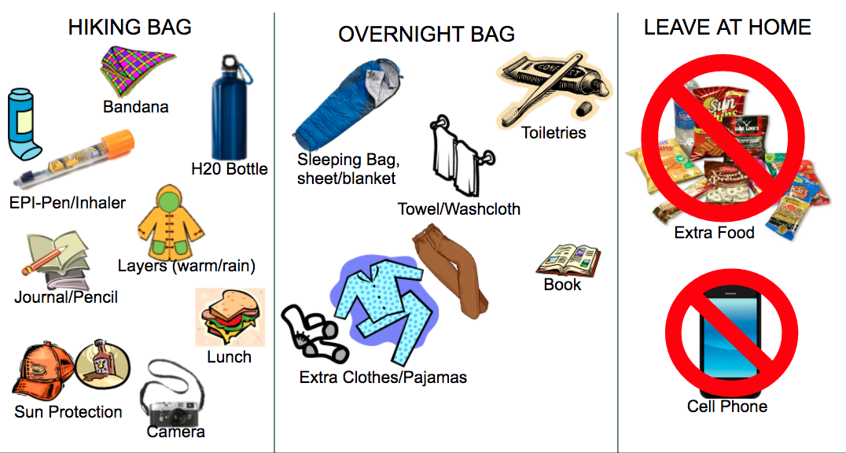
What to Pack
Pillow
Please use the list given to you or the NatureBridge Packing List (English or Spanish)
Notes:
A complete packing list can be found on our website, under the “Plan your Program” section for ‘Students and Families’. NatureBridge’s cell phone policy is provided on a future slide in this presentation.

Slide 18
Footwear
Good footwear is functional, but doesn’t need to be fancy!
Notes:
Please don’t buy new shoes for the trip! We don’t want participants to develop blisters because footwear is not broken in. Comfort and safety are key for footwear!

Slide 19
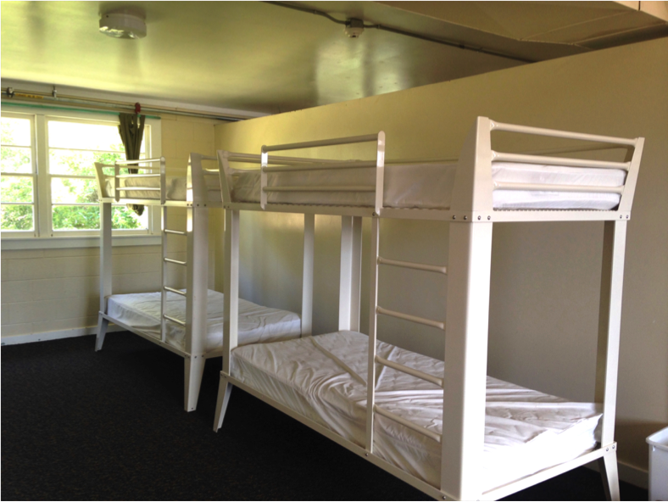
Dorms
Each school will have its own designated dorm space in the 2022-2023 school year.
Students may only be in the dorms when an adult is present.
At least one adult for every 20 students will sleep in the dorms.
Bathrooms & showers may be shared with participants with another group.
Notes:
And this is where you’ll sleep! All dorms have automatic locks and can only be opened by adults with the pin code. Students are not given the pin code because they should be with an adult at all times.

Slide 20
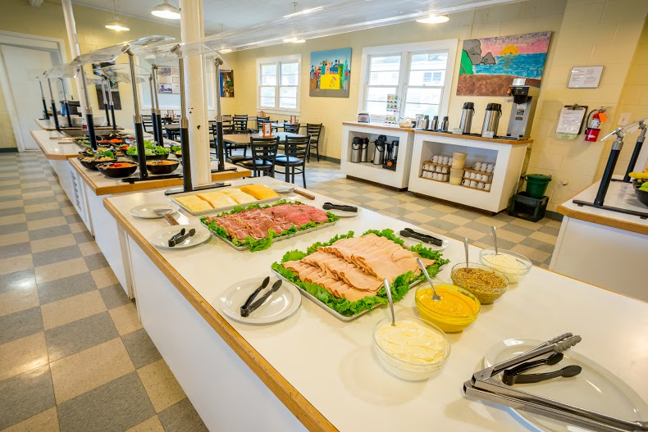
Food
Students bring their own lunch on arrival day. All other meals are provided.
Online participant registration forms collect dietary restrictions. Complete this form at least 30 days prior to arrival.
Schools may share dining hall with participants from other schools.

Slide 21
Student and Family Agreements
All students and adults are expected to fully participate in all aspects of the program.
Parents/guardians are responsible for picking up their child if they are too ill to hike, injured or need to be sent home because of a behavior violation.
Safe and inclusive behavior is important. Participants are expected to follow all behavior guidelines. Students must review student expectations in English or Spanish prior to arrival.
NatureBridge Cell Phone Policy:
Policy [4.16] When student participants are in learning groups with NatureBridge educators and school chaperones, cell phones should be set in airplane mode and used only for taking photos, video or specific school projects. When student participants are not in learning groups, any cell phone use will be supervised by teachers and chaperones. Student participants may not use cell phones in NatureBridge cabins, dining halls, or bathrooms.
Notes:
Cell phones are not allowed for use in the dorms, bathrooms or while hiking on trail. We understand that many students may use it for their camera, but we encourage the school to designate an adult to take photos on behalf of the whole group.

Slide 22
Next Steps
Online Participant Registration Forms
All program participants, students AND adults, must complete this form. Your group coordinator will send the link to you.
Communication with NatureBridge
NatureBridge maintains direct contact with your school’s group coordinator. Please direct all questions to that individual.
Visit NatureBridge’s website to find information for Student, Families and Chaperones
Notes:
NatureBridge now has online registration! That’s progress!

Slide 23
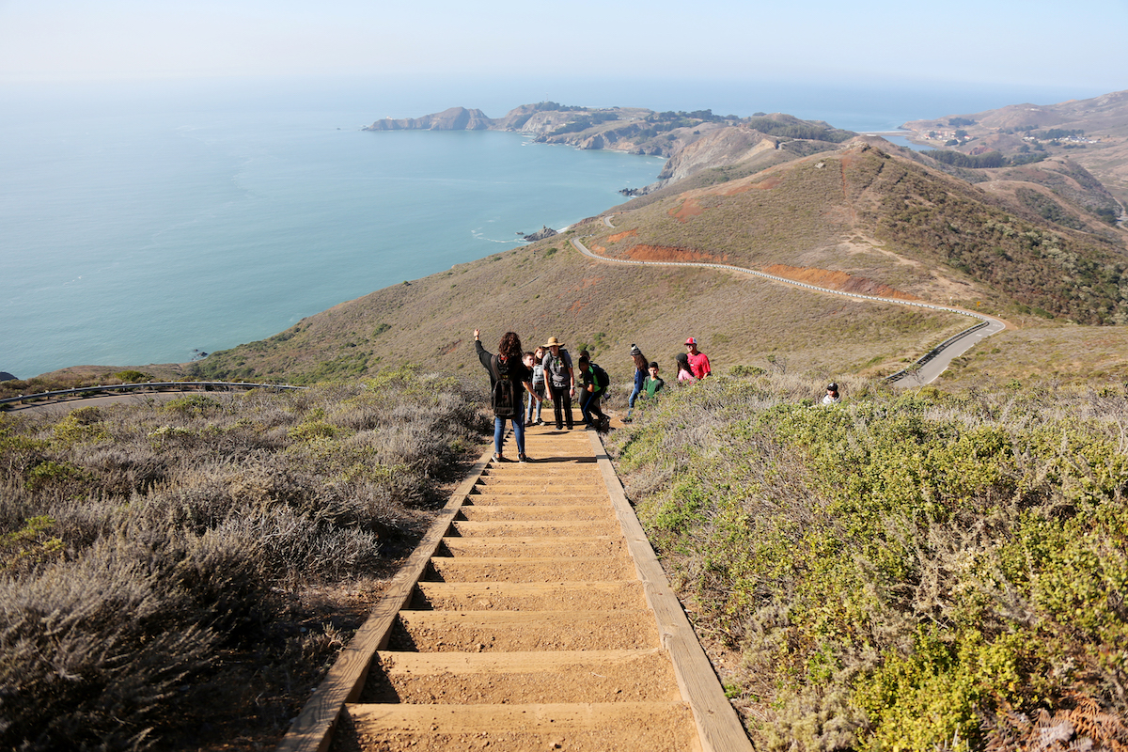
Questions?
NatureBridge is eager to welcome your school to its Golden Gate campus in
the Marin Headlands!

