Slide 1
Olympic National Park

Slide 2
Overview
School & Group Environmental Science
Why NatureBridge?
Olympic Classrooms
Olympic Experiences
Sample Day
Learning Groups
Accommodations
What to Bring
Safety
Student Agreements
Next Steps

Slide 3
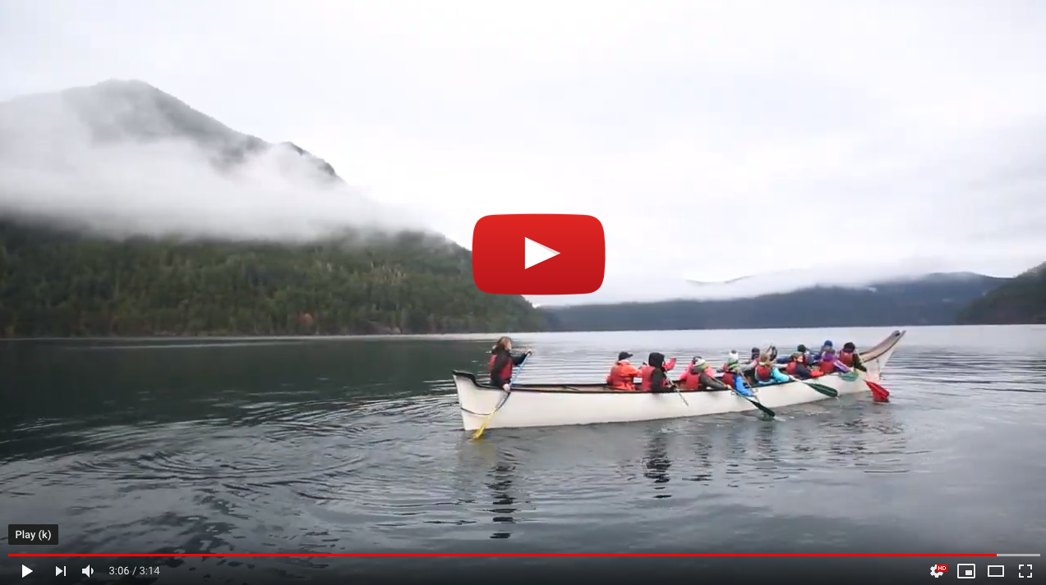
Why NatureBridge?
Notes:
NatureBridge connects young people to the wonder and science of the natural world, igniting self-discovery and inspiring stewardship of our planet. Through our overnight environmental science programs, we take more than 30,000 kids each year into our national parks to explore the outdoors, connect with their peers, discover themselves and develop a lasting relationship with the environment. Here’s a short video that gives you a glimpse into a NatureBridge program (image above is linked or you can access video here: https://youtu.be/hA6SJ3zwPfk)

Slide 4
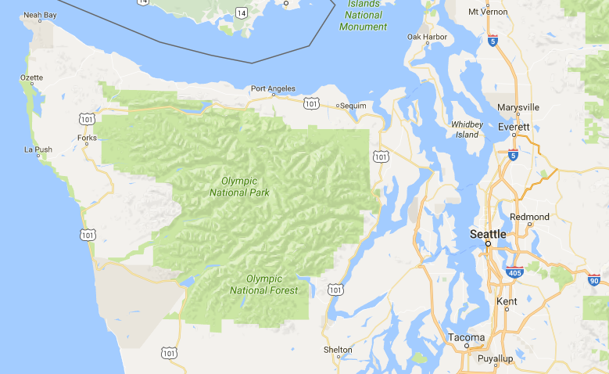
Olympic National Park
Notes:
Olympic National Park covers almost one million acres of Washington State’s Olympic Peninsula which is bounded on the west by the Pacific Ocean, the north by the Strait of Juan de Fuca, and the east by Hood Canal. NatureBridge’s campus is located within the national park on the south shore of Lake Crescent, 30 miles west of Port Angeles. Travel time from Seattle is approximately three hours. Route options include driving around through Tacoma and up the Kitsap Peninsula, or crossing Puget Sound by ferry to Bainbridge Island or Kingston. All of these routes cross the Hood Canal Bridge, pass Sequim and Port Angeles before arriving in Olympic National Park.

Slide 5
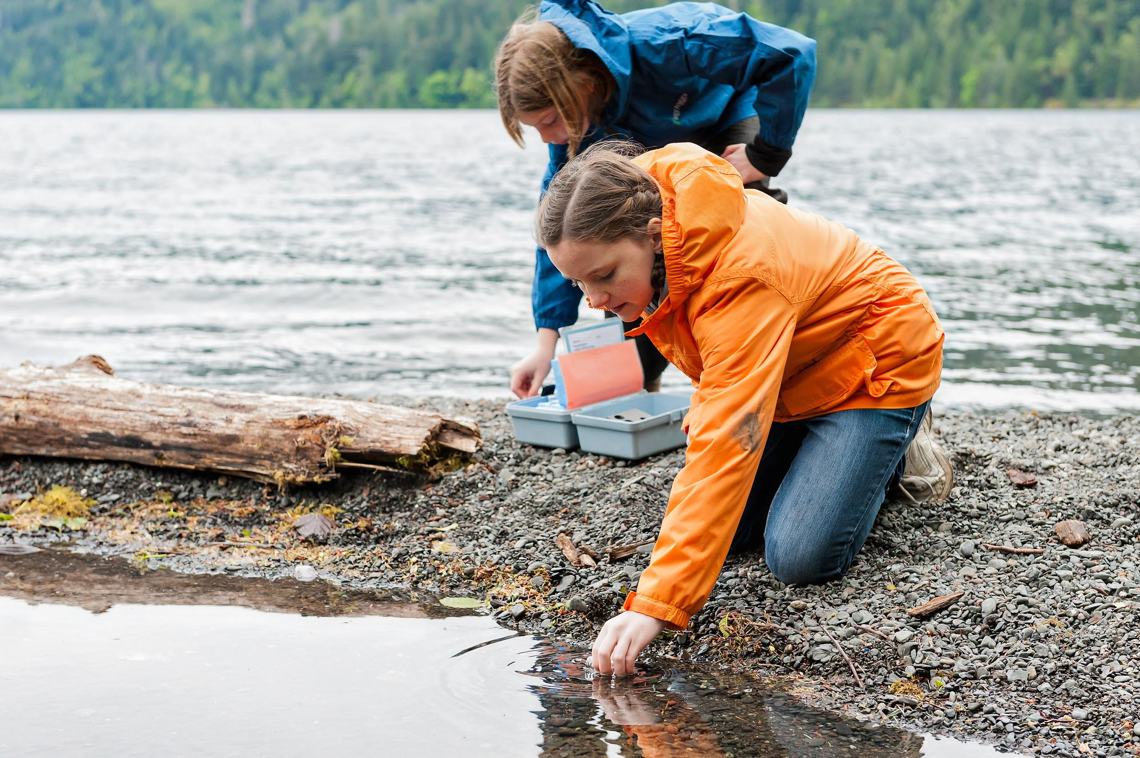
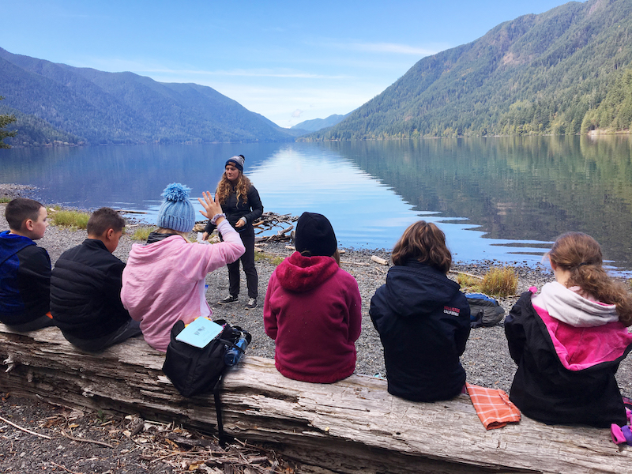
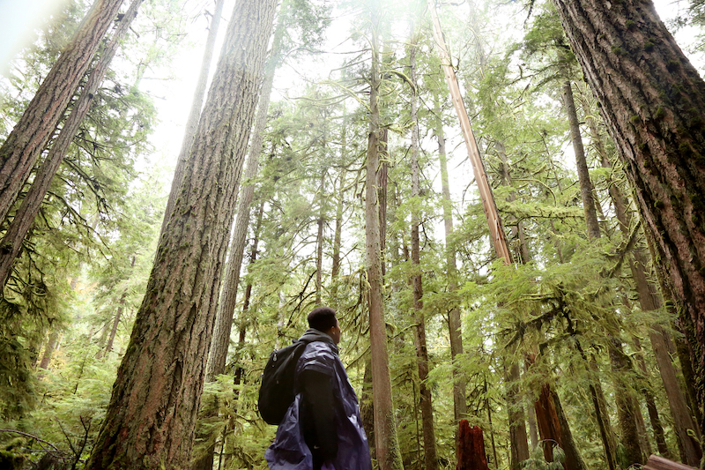
Olympic Classrooms
Barnes Creek
Lake Crescent
Old Growth Forest
Notes:
NatureBridge’s Olympic National Park campus has stunning outdoor classrooms including an old growth forest, Lake Crescent and Barnes Creek

Slide 6
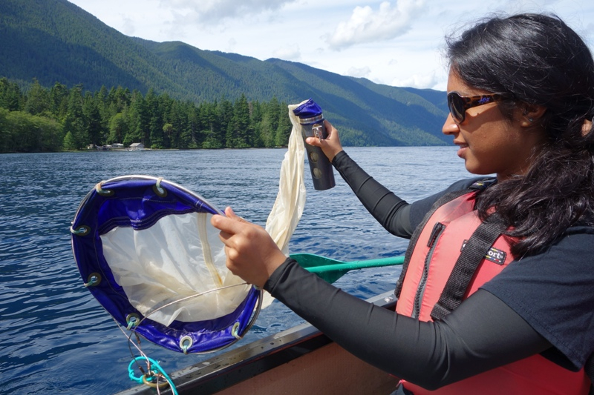
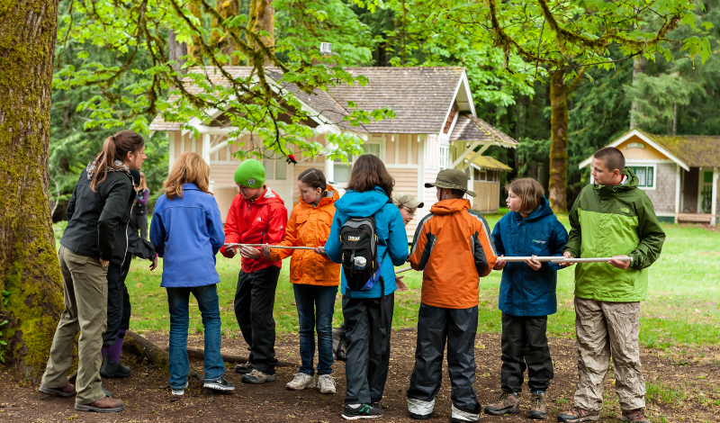
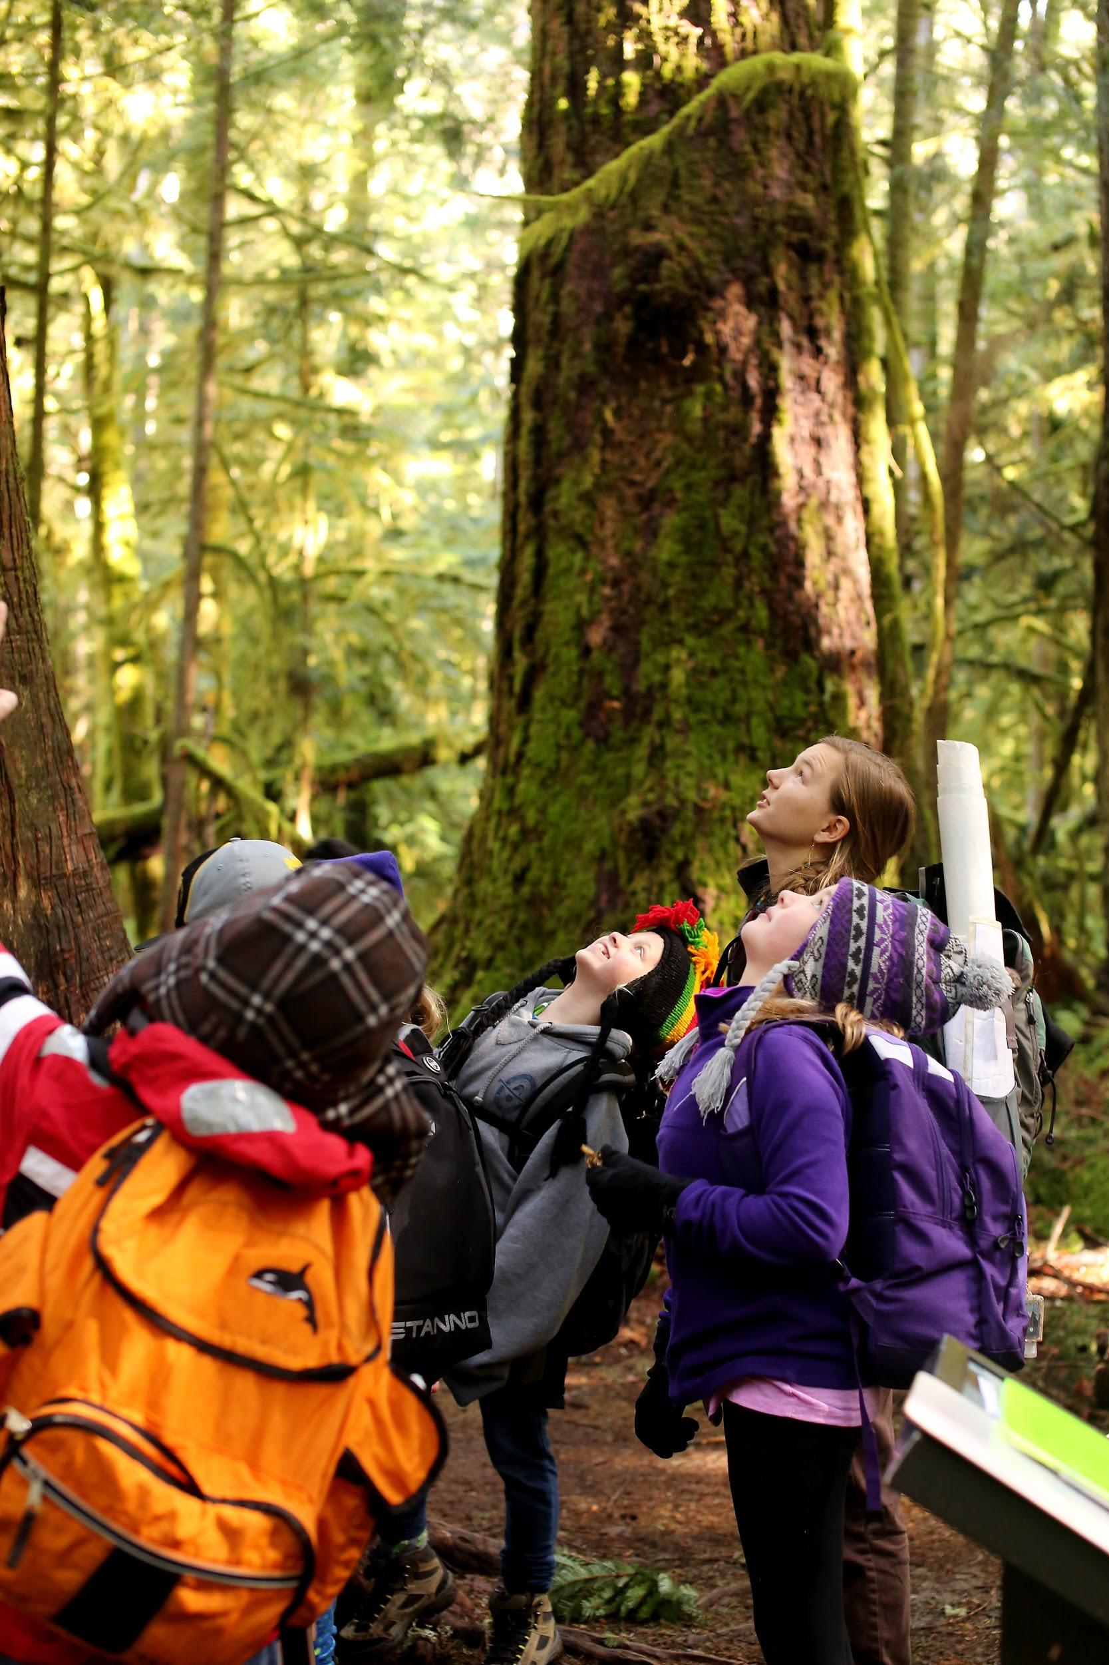
Olympic Experiences
Experiencing the Outdoors
Environmental Science
Teambuilding and Self-Reflection
Notes:
Students connect to nature + science + self and their peers.

Slide 7
Sample Day
6:30 a.m.
7:00 a.m. or 8:00 a.m.
9:00 a.m. to 4:00 p.m.
4:00 p.m.
5:00 p.m. or 6:00 p.m.
7:00 p.m. to 8:00 p.m.
8:30 p.m.
Wake up and prepare for day
Breakfast in the Rosemary Inn dining hall
Instructional day in learning groups with lunch on trail
Recreation time organized & supervised by group’s adults
Dinner in the Rosemary Inn dining hall
Evening program
Prepare for bed

Slide 8
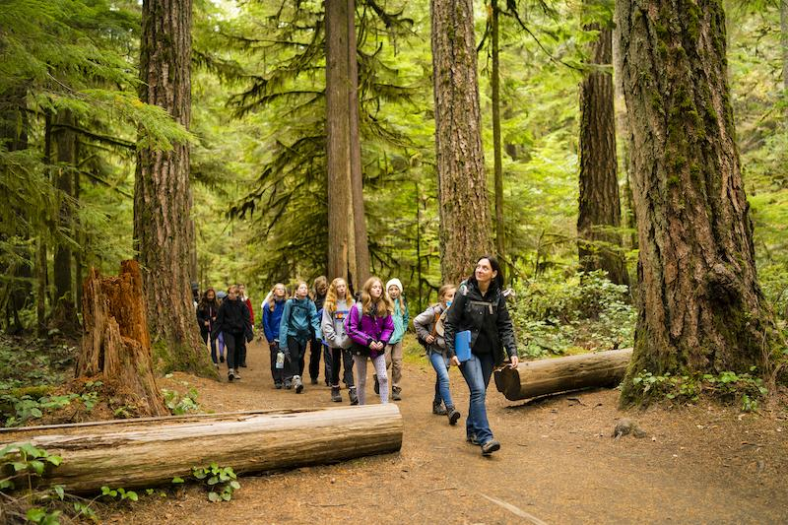
Learning Groups
Learning groups are composed of 15 or fewer students and 1 or 2 chaperones.
Groups explore the natural world from 9 a.m. to 4 p.m. every program day.
Your school’s group coordinator assigns students to learning groups.

Slide 9
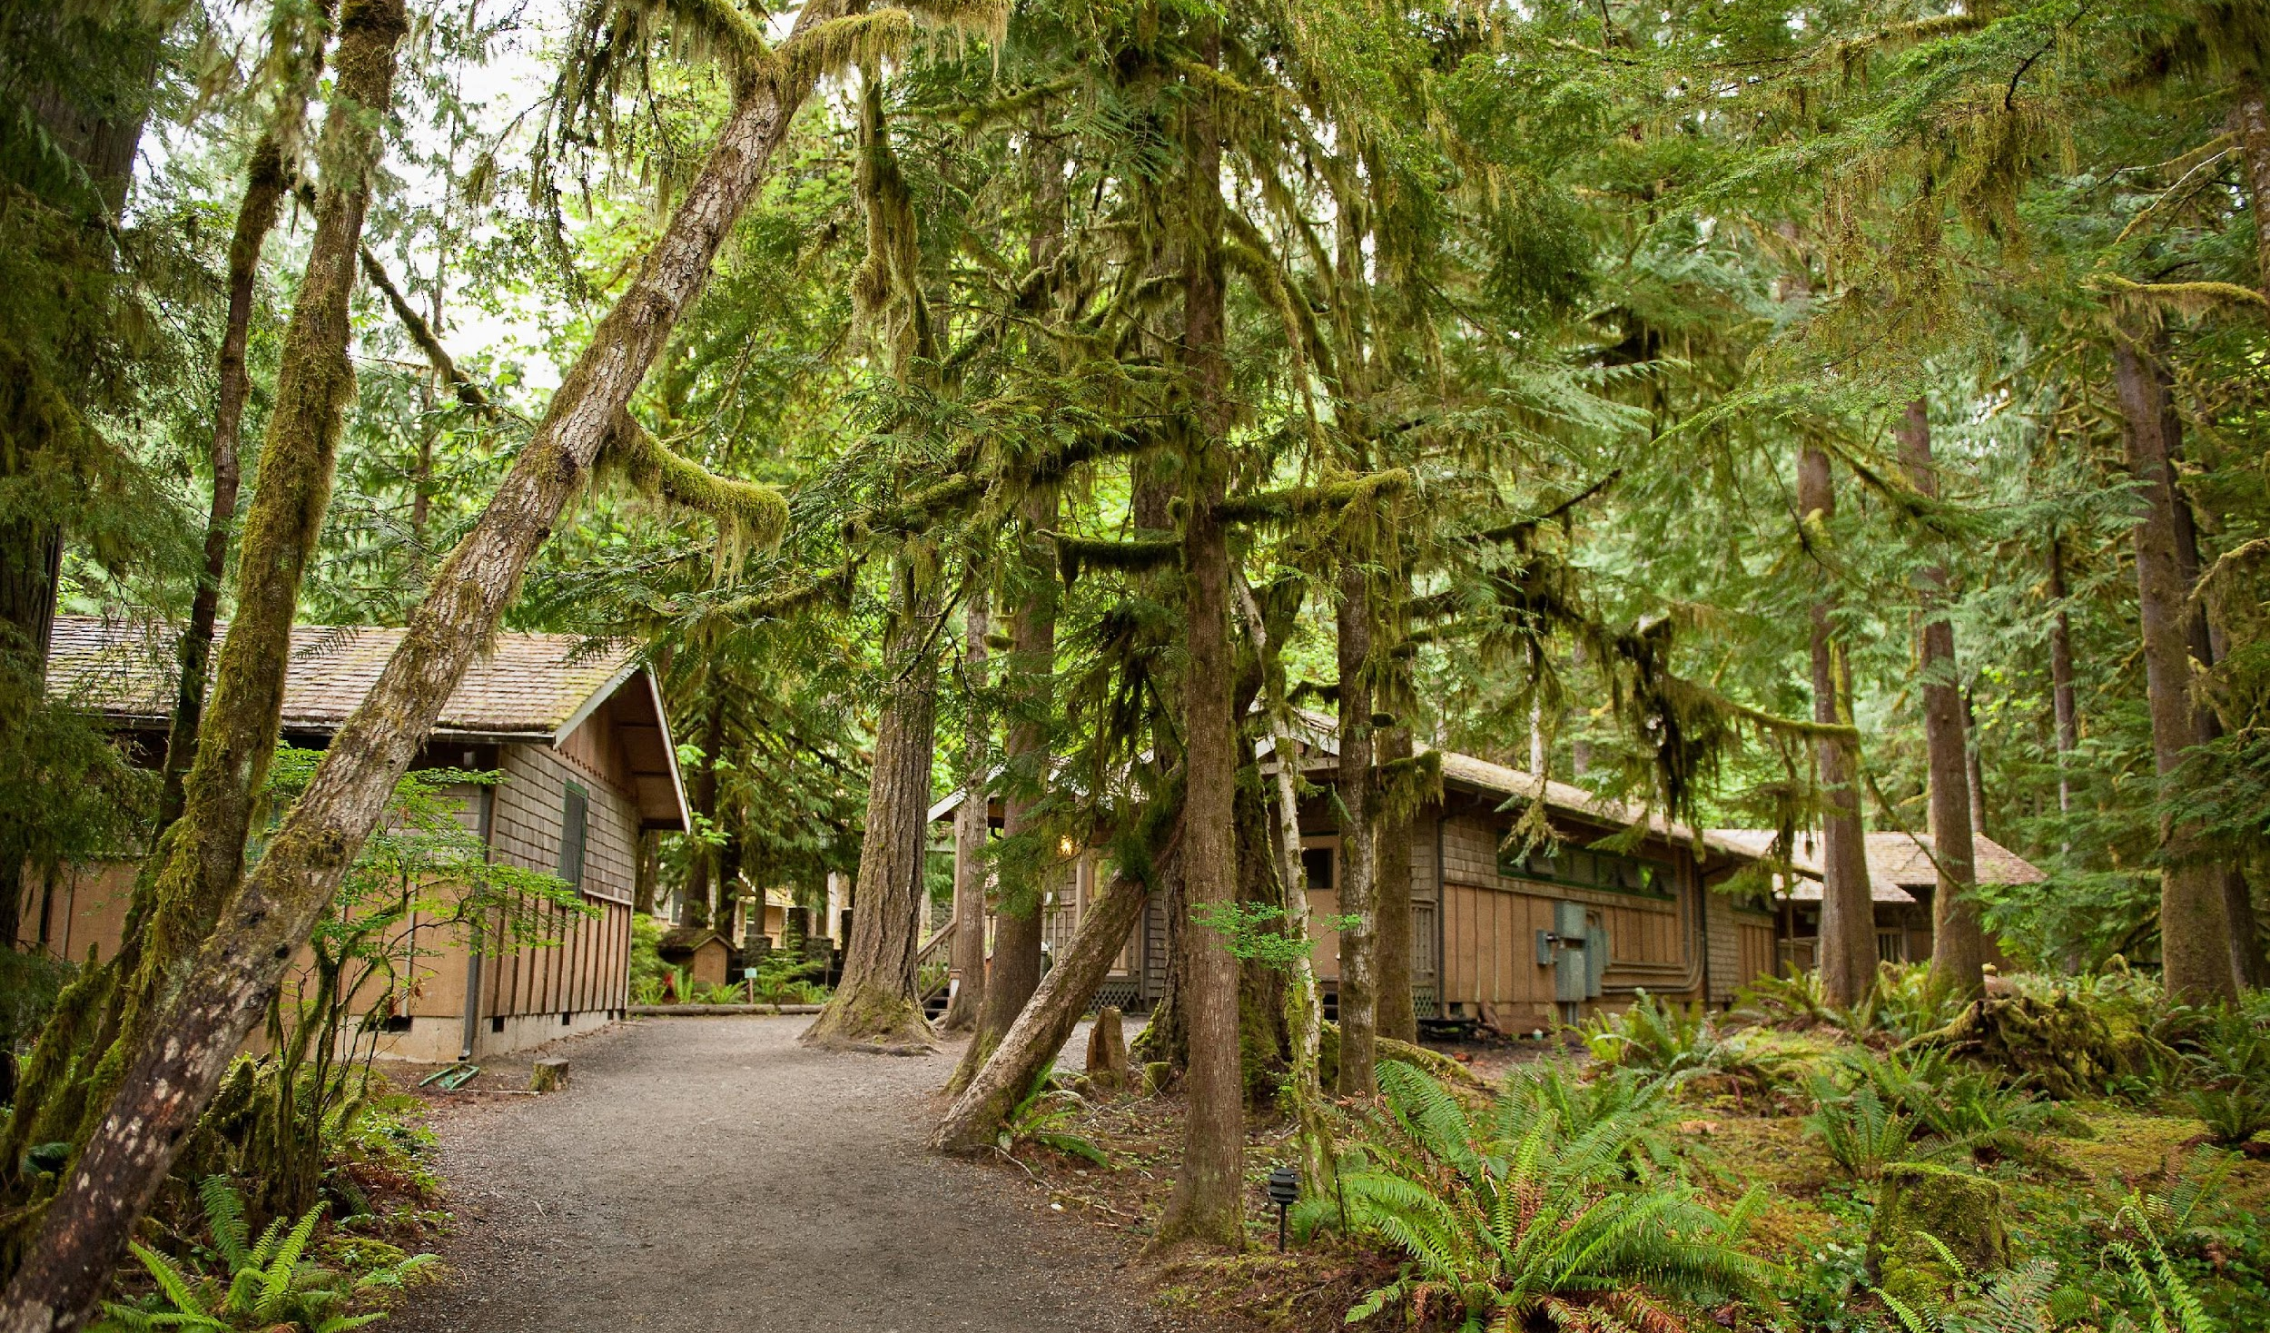
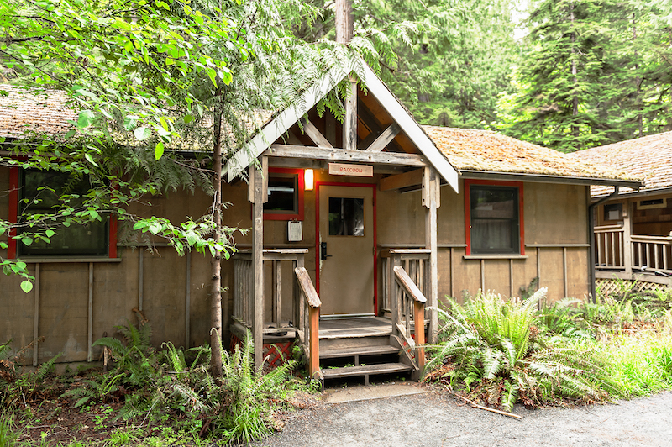
Lodging at Olympic
Lodging for students and chaperones is in seven dorm-style cabins.
Chaperones are in charge of supervising students in the cabins at all times.
Your school’s group coordinator assigns students and chaperones to cabins.
Notes:
In each cabin, bedroom doors open onto a central hallway. The exterior door has a keypad lock. Chaperones are in charge of the keypad code.

Slide 10
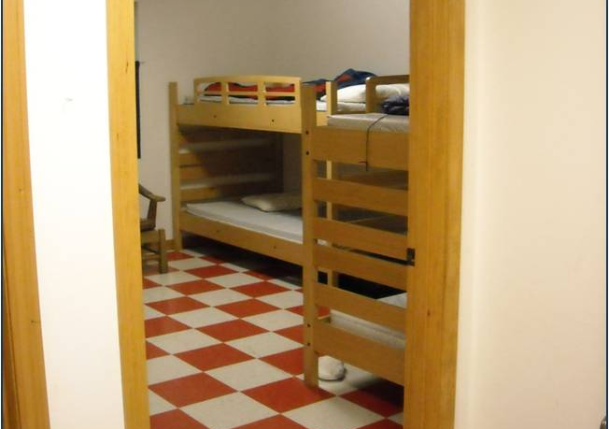
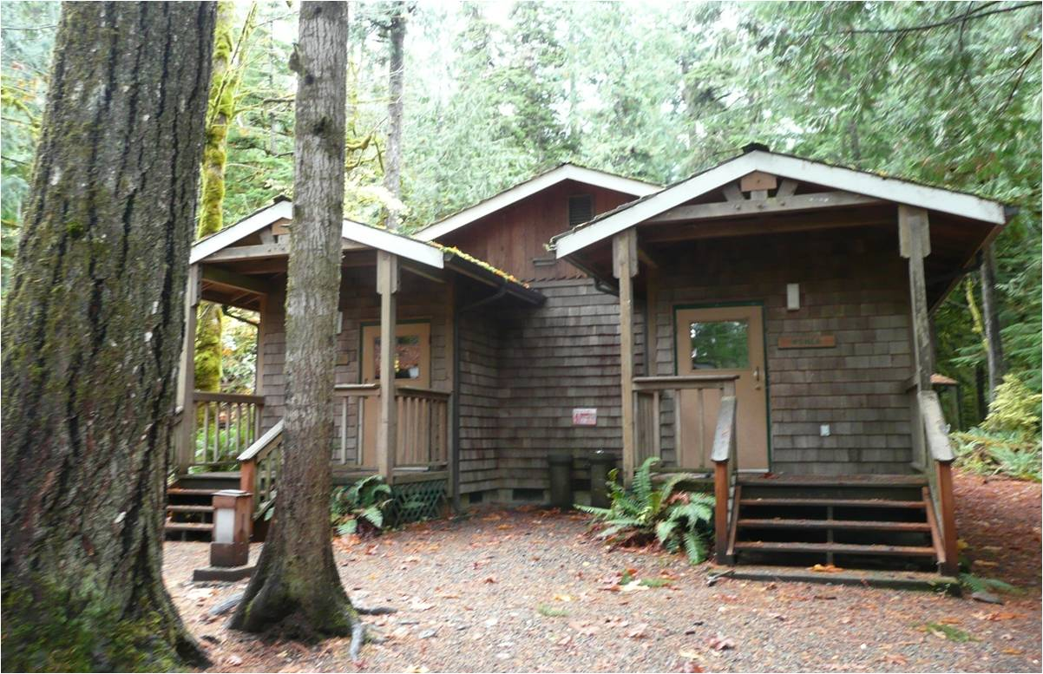
Lodging at Olympic
Each bedroom has three bunk beds. Your school’s group coordinator assigns students and chaperones to cabins and bedrooms.
The bathhouse has separate sections for men and women. Each of these sections has private stalls for toilets and showers. Two private, gender neutral restrooms with showers are in the back of the bathhouse.
Notes:
Three cabins have six rooms, three have four rooms, and one has two rooms. Participants bring their own bedding. Each room has one double mattress and five twin mattresses. .

Slide 11
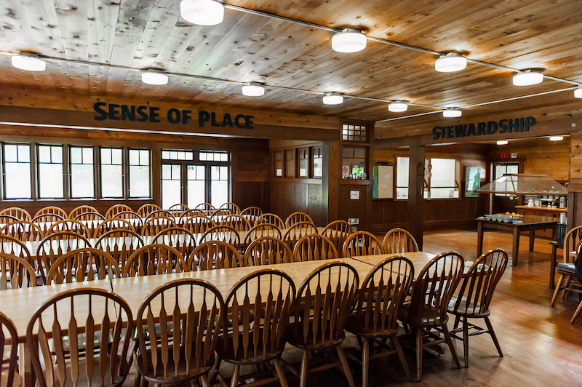
Dining at Olympic
Breakfast and dinner are served buffet-style in the Rosemary Inn dining hall.
Lunch is served on trail in learning groups.
Kid-friendly wholesome meals are prepared by NatureBridge staff.
Most dietary restrictions can be accommodated.
Notes:
Breakfast and dinner are served in the dining hall in one hour shifts. The hall is shared with all schools on campus. Most dietary restrictions, including vegetarian, vegan, gluten-free, and dairy-free can be accommodated. All participants are asked to bring their own lunch on arrival day.

Slide 12
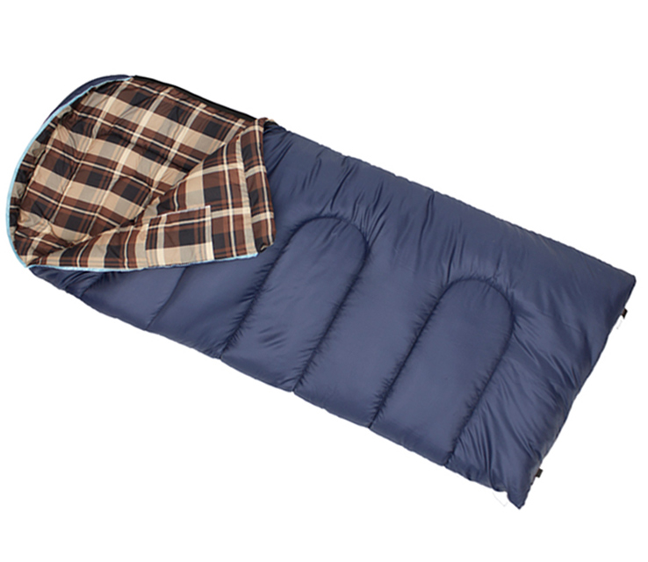
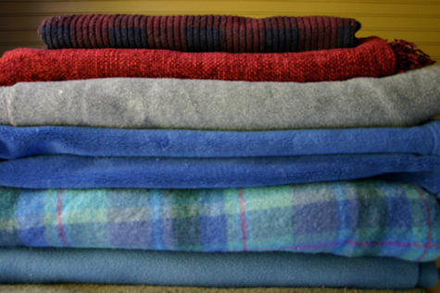
What to Bring: Bedding
Warm Sleeping Bag
and/or
Warm Blankets and Sheets Pillow
Notes:
Full packing list can be found here https://naturebridge.org/sites/default/files/2018-12/OlympicPackingList.pdf

Slide 13
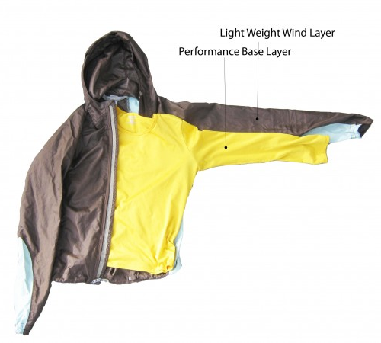
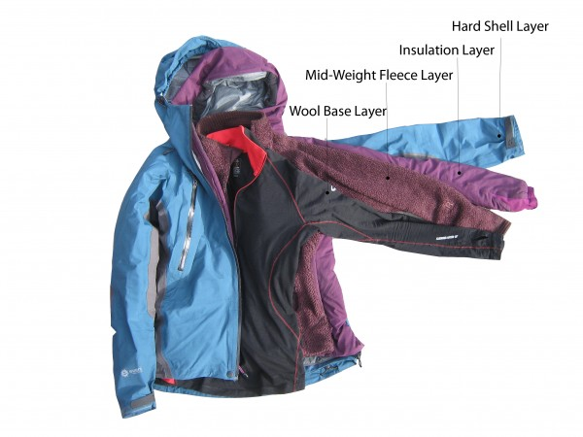
What to Bring: Clothing
Good gear is functional, but doesn’t need to be fancy!
Read the packing list carefully and be prepared for all kinds of weather and for getting dirty.
Rain gear is always required.
For Warm Weather Trips: May-September
For Cold Weather Trips: October-April
Link: Outdoor Gear Lab Layering Systems
Notes:
Some gear is available if students need to borrow it: ponchos, rain pants, gloves, and water bottles.

Slide 14
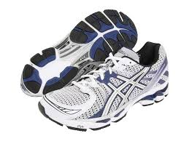
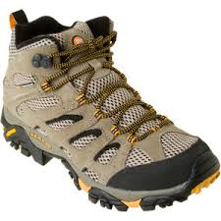
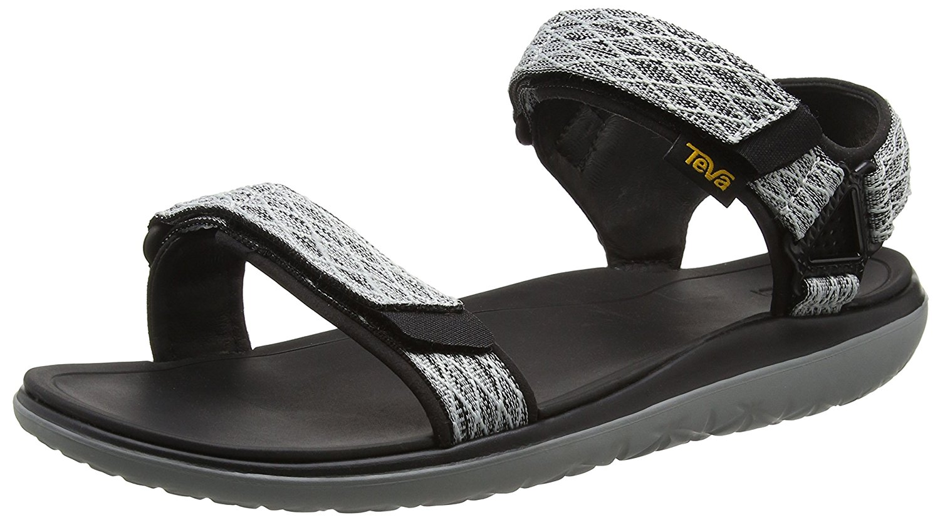
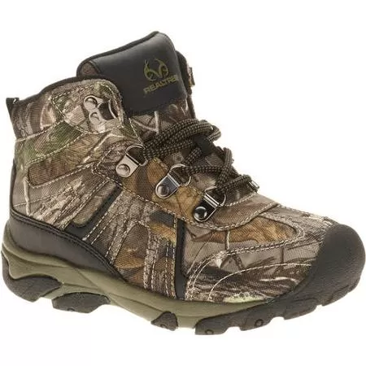
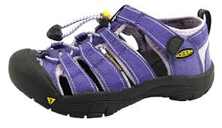
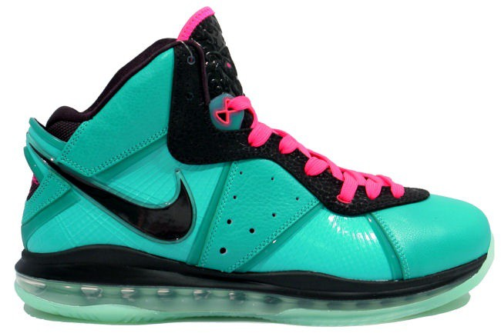
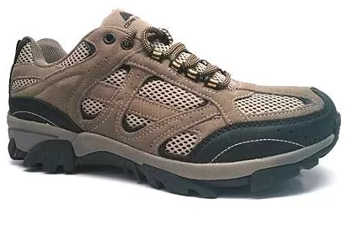
What to Bring: Footwear
Please pack sturdy, broken-in shoes or boots for your trail day
(you can bring extra shoes for around camp).
Yes Waterproof in case of rain or snow. In warmer months, broken in athletic shoes may be worn. | No Not sturdy enough or too nice for hiking in the mud.
Notes:
Please make sure participants do not wear open toed shoe. Sandals are for shower use only.

Slide 15
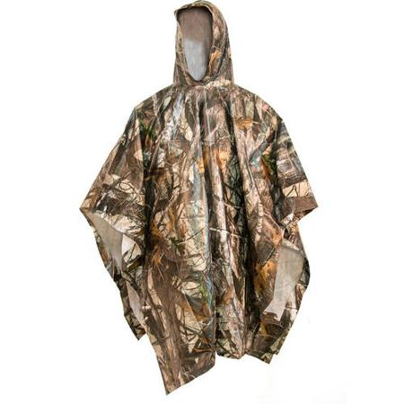
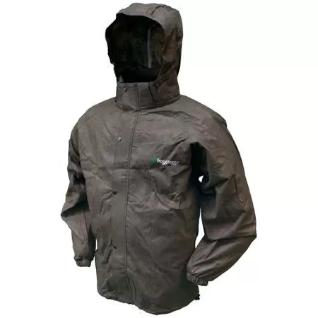
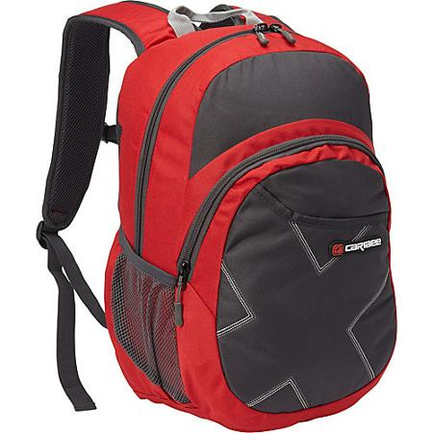
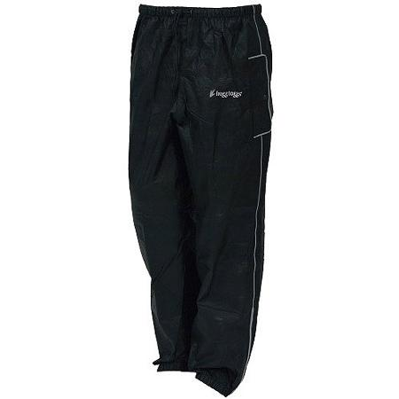
What to Bring: Day Pack
TWO
Liter-sized Water Bottles
Bandana/ Crumb Catcher for Trail Lunch
Day Pack
Waterproof Top and Bottom or Poncho and Umbrella

Slide 16
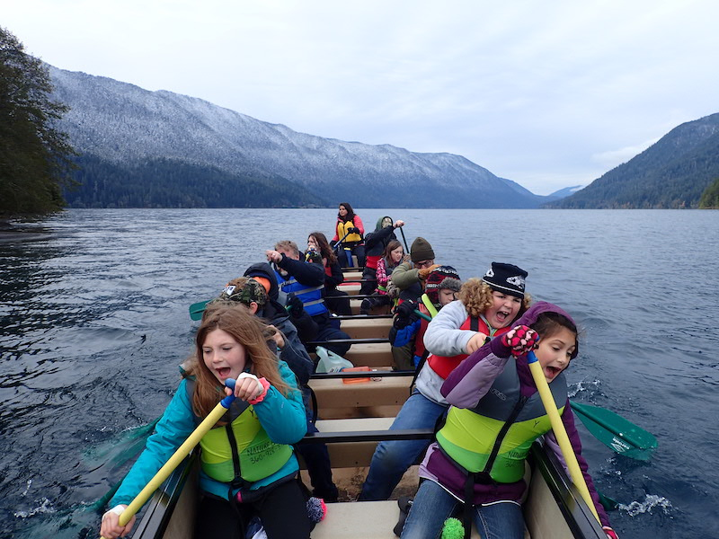
Safety
NatureBridge administrative staff is available 24 hours a day. Emergency medical services are 30 minutes away. Olympic National Park law enforcement is available at all times.
Students are supervised at all times:
From 9 a.m. - 4 p.m. students are in learning groups with one NatureBridge staff member and one or two school chaperones.
From 4 p.m. - 9 a.m. of the next day, supervision is the responsibility of school chaperones and teachers.
NatureBridge educators’ basic requirements:
Bachelor’s Degrees or equivalent work experience
Cleared background checks.
Wilderness First Responder (WFR) certification
Notes:
Olympic’s education staff are Epi-pen certified. Students are asked to use the “buddy” system when they are on campus so they are always in close proximity to another student.

Slide 17
Student Agreements
Safe and inclusive behavior is important. Students are expected to follow all behavior guidelines. Students must review student behavior expectations prior to the trip.
NatureBridge Cell Phone Policy:
Policy [4.16] When student participants are in learning groups with NatureBridge educators and school chaperones, cell phones should be set in airplane mode and used only for taking photos, video or specific school projects. When student participants are not in learning groups, any cell phone use will be supervised by teachers and chaperones. Student participants may not use cell phones in NatureBridge dorms, dining halls, or bathrooms.

Slide 18
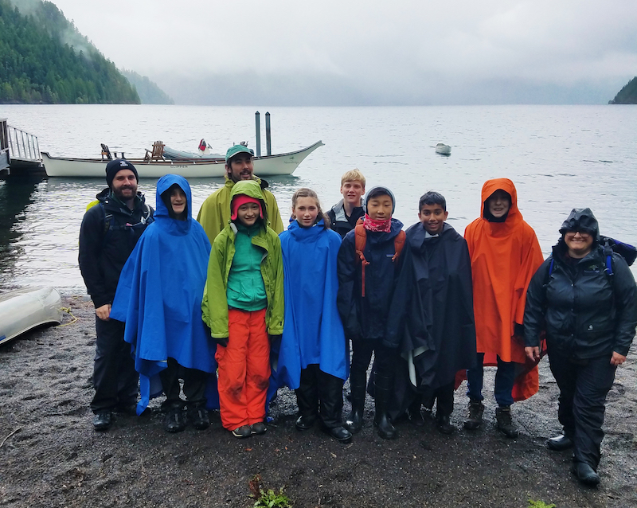
Next Steps
Planning:
Find important registration forms and planning documents here.
Modes of Communication:
NatureBridge will be in direct contact with your school’s group coordinator. Please direct all your questions to that individual.
Timeline:
Please adhere to all deadlines set by your school’s group coordinator. This ensures that NatureBridge can provide the safest, highest quality program for your student.
Contact Person:
(Insert name of school group coordinator)

