Slide 1
Yosemite National Park

Slide 2
Overview
Why NatureBridge?
Yosemite’s Classroom
A Typical Day in Yosemite
Learning Groups
Accomodations in Yosemite
What to Bring
Student and Family Agreements
Next Steps

Slide 3
Why NatureBridge?

Slide 4
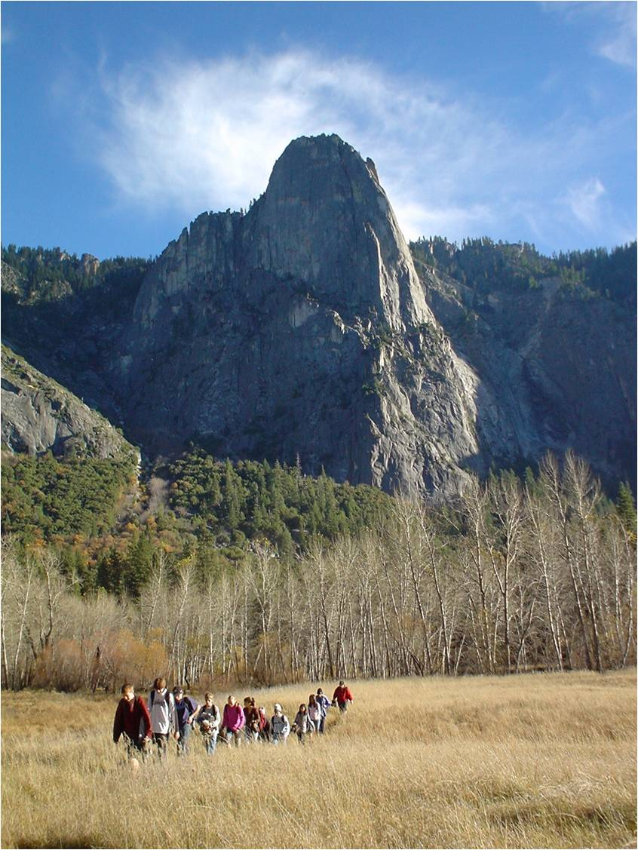
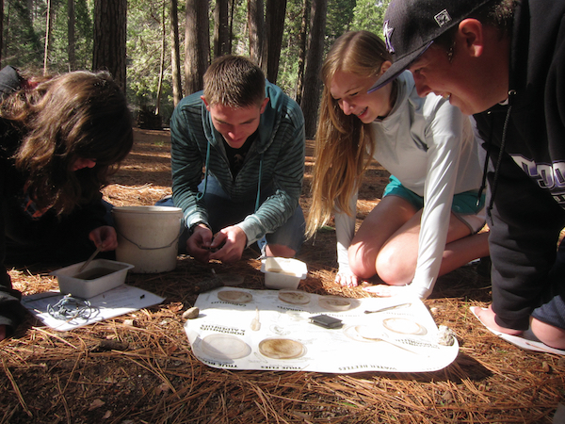
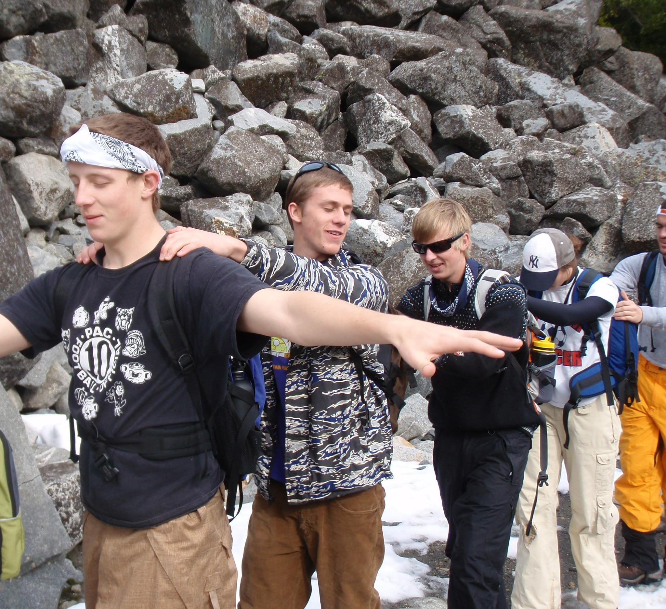
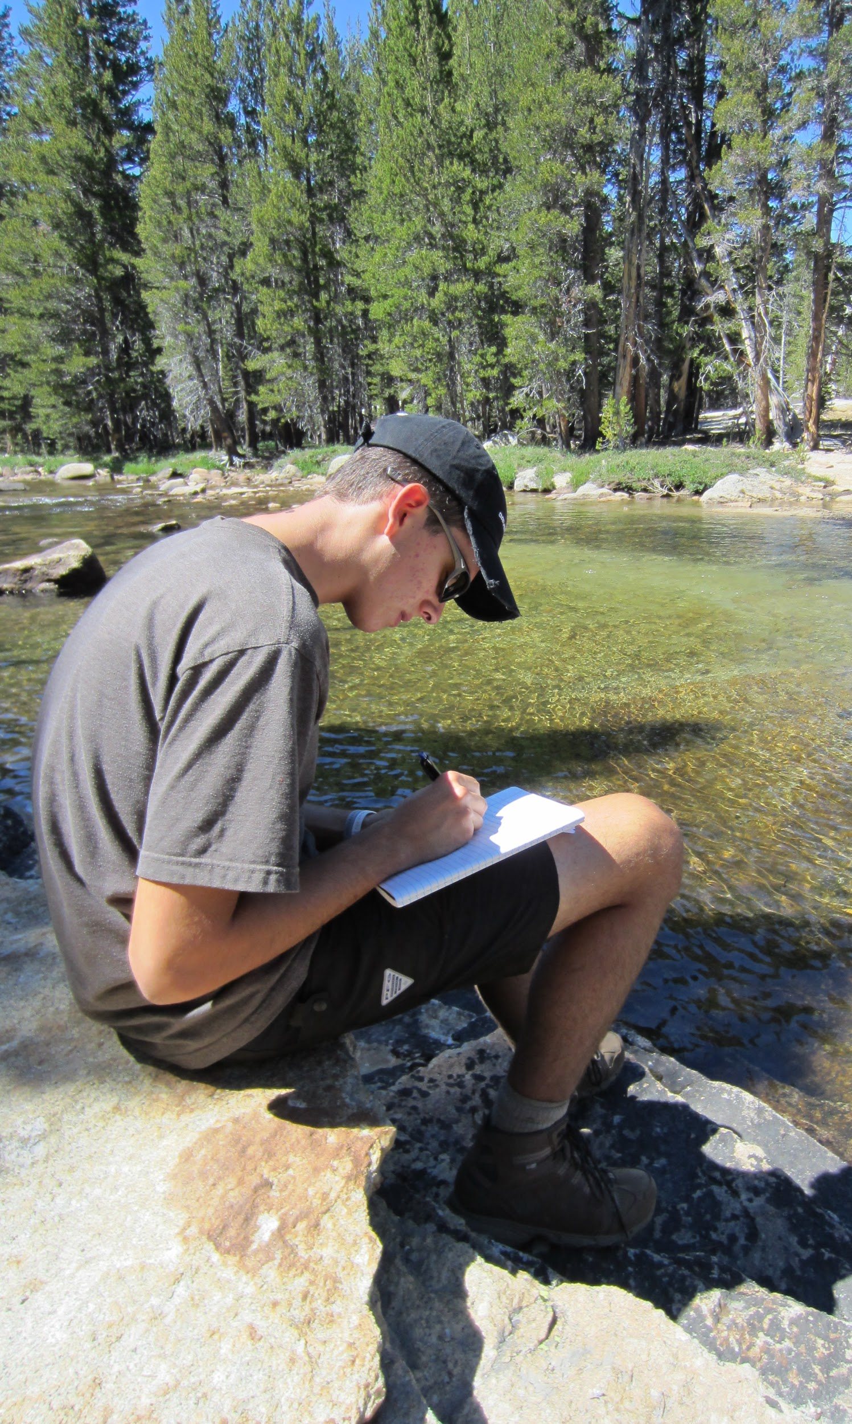
Yosemite’s Classroom
Environmental Science
Experiencing the Outdoors
Teambuilding and Self-Reflection

Slide 5
Sample Day
6:00-6:30 a.m. Wake-up and get ready for the day
7:00-8:00 a.m. Breakfast
8:30 a.m. Meet NatureBridge Educators
8:45 a.m. Hit the trail for the day!
Examples of what the day might include:
Challenge hike up Tenaya Canyon on the Snow Creek Switchbacks
Remove small conifer trees as part of a stewardship project
Observe evidence of glaciation in Yosemite Valley
3:30-4:30 p.m. Arrive back from trail
4:30-5:00 p.m. Supervised free time
5:00-6:00 p.m. Dinner
7:00 p.m. Evening Program

Slide 6
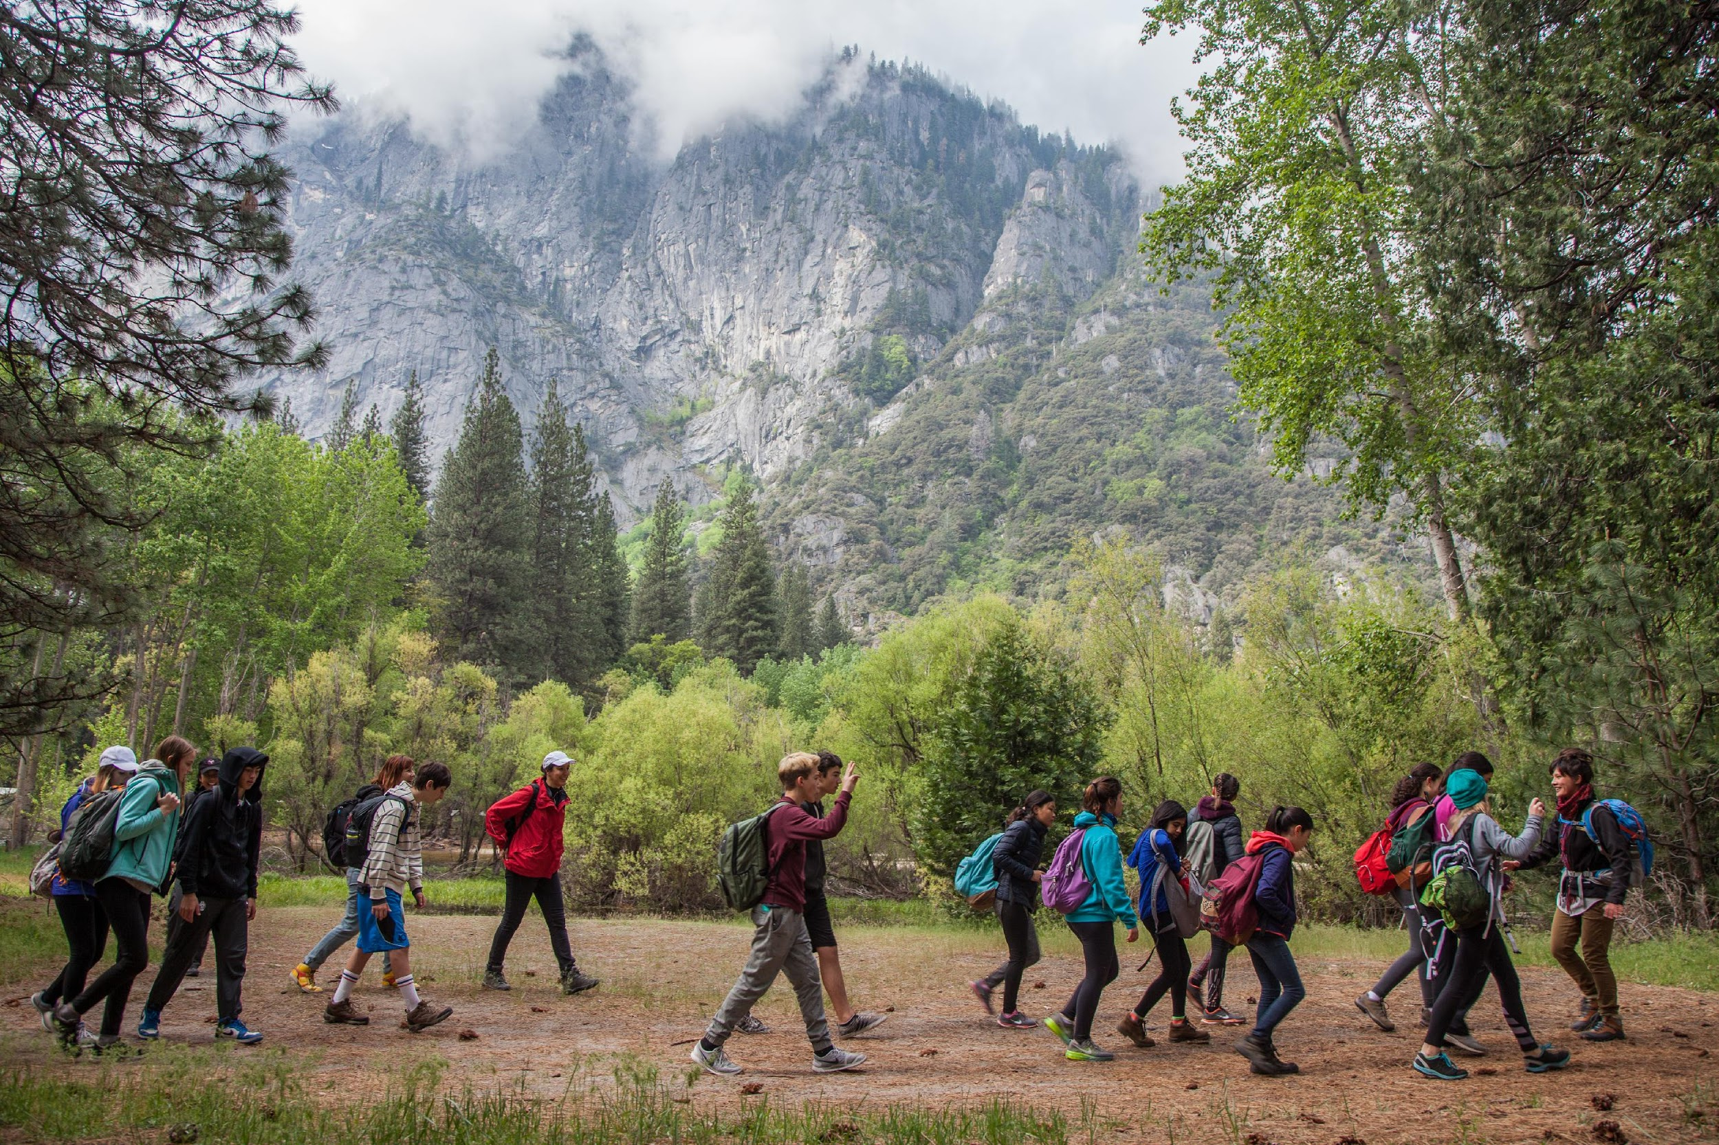
Trail Groups
Approximately 12-14 students and 1 or 2 chaperones
Spends the day together on trail
Learning Groups will be arranged by your school’s planning coordinator

Slide 7
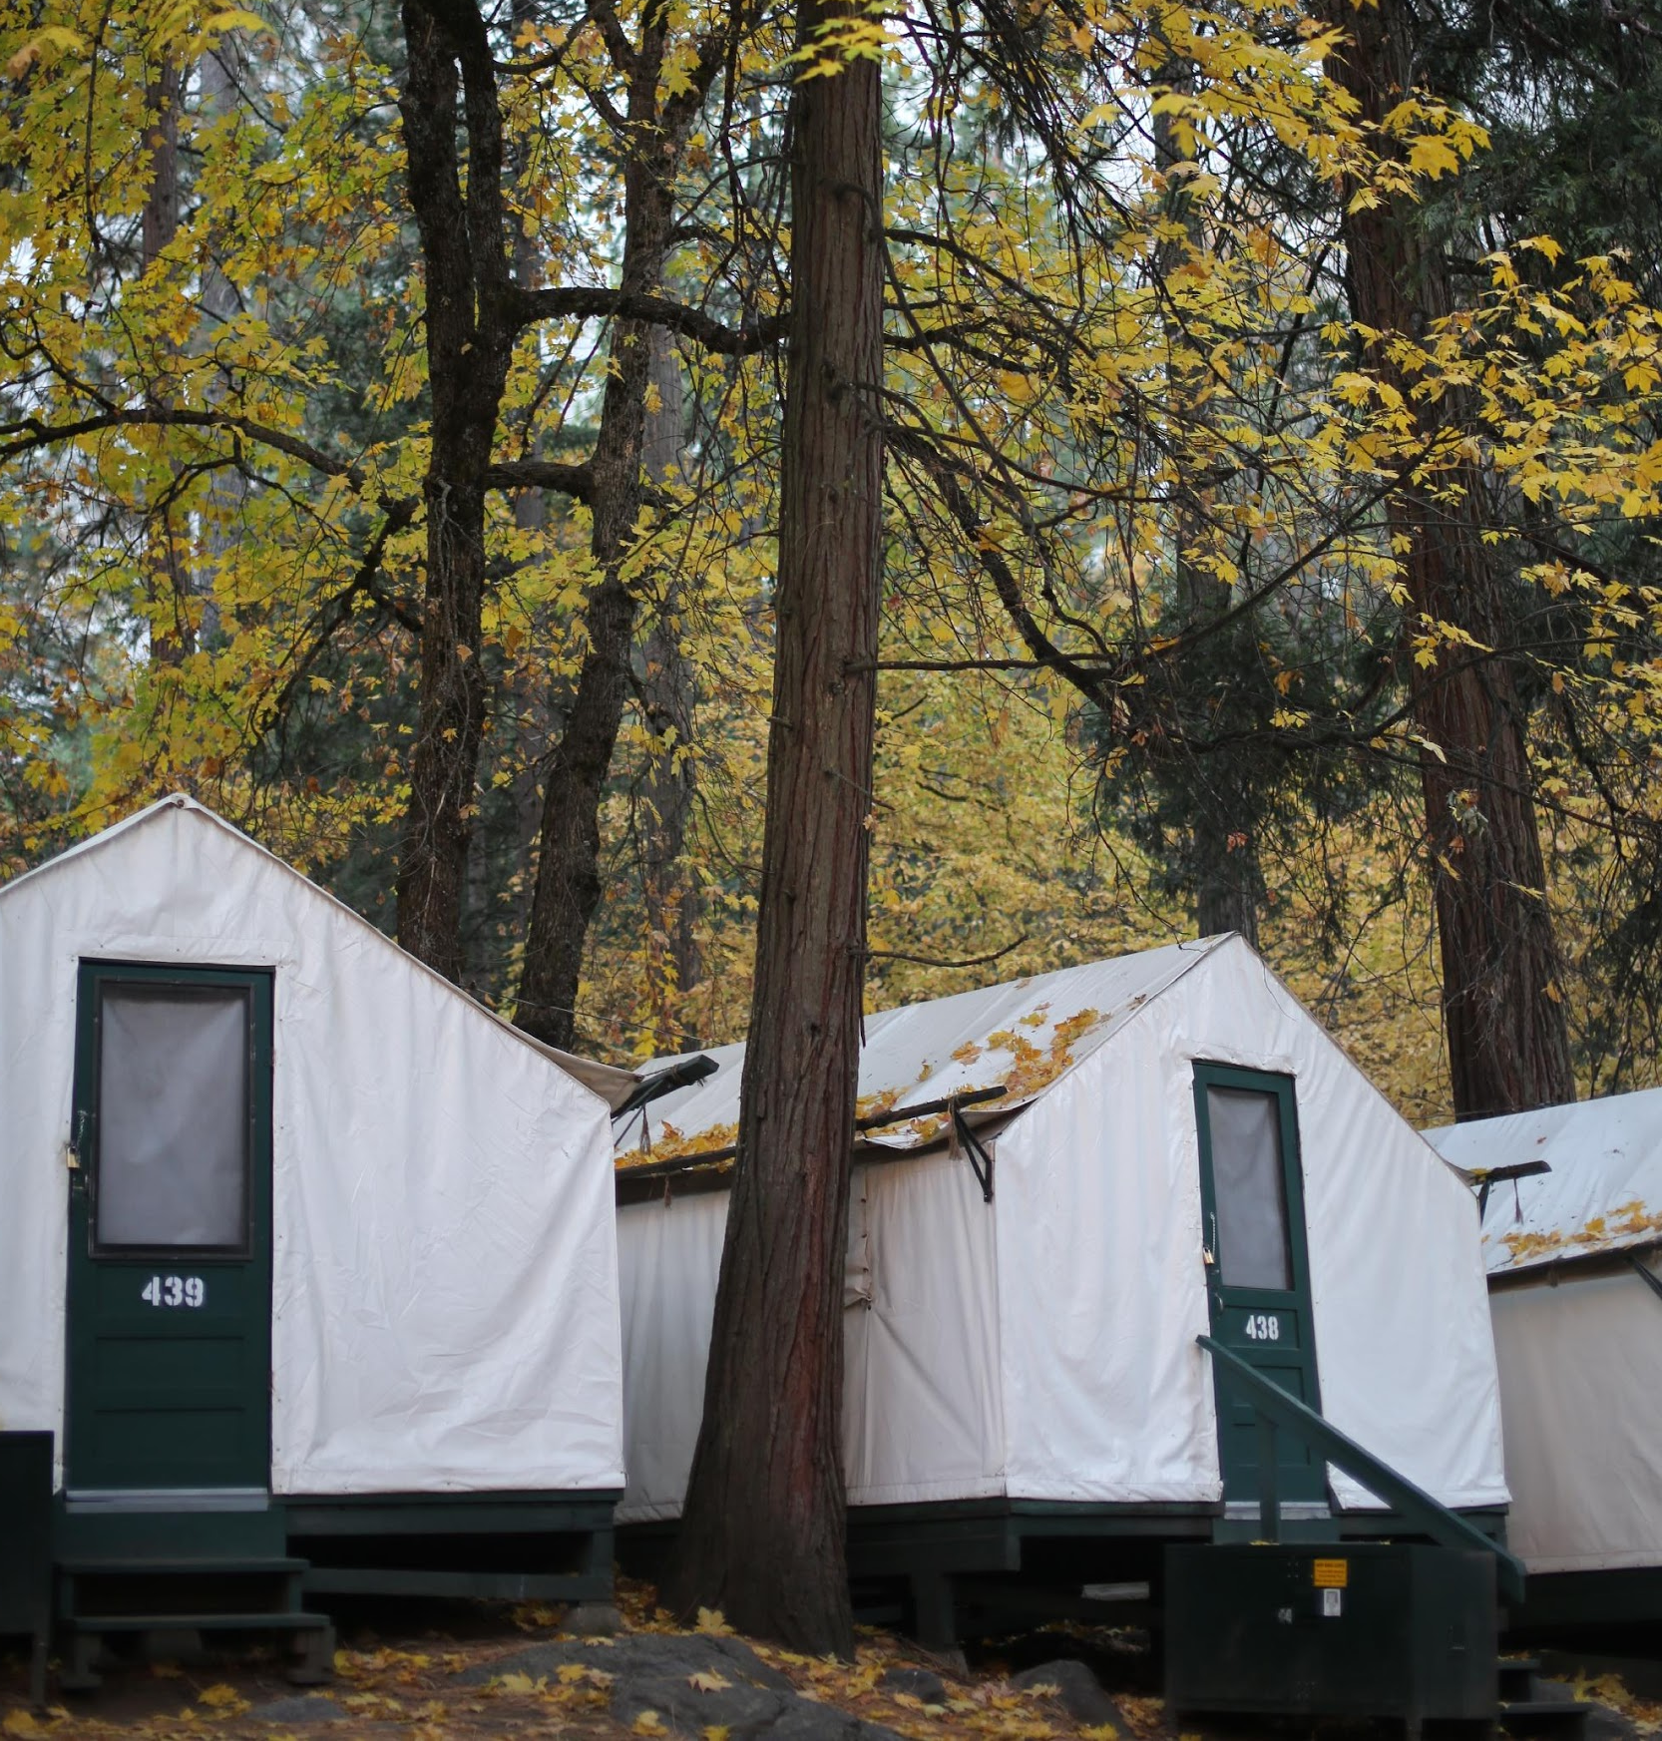
Lodging at Yosemite
Half Dome Village in Yosemite Valley
Tent cabins accommodate 4 students
Student and chaperone cabins are located in the same area
Cabin groups will be arranged by your school’s planning coordinator

Slide 8
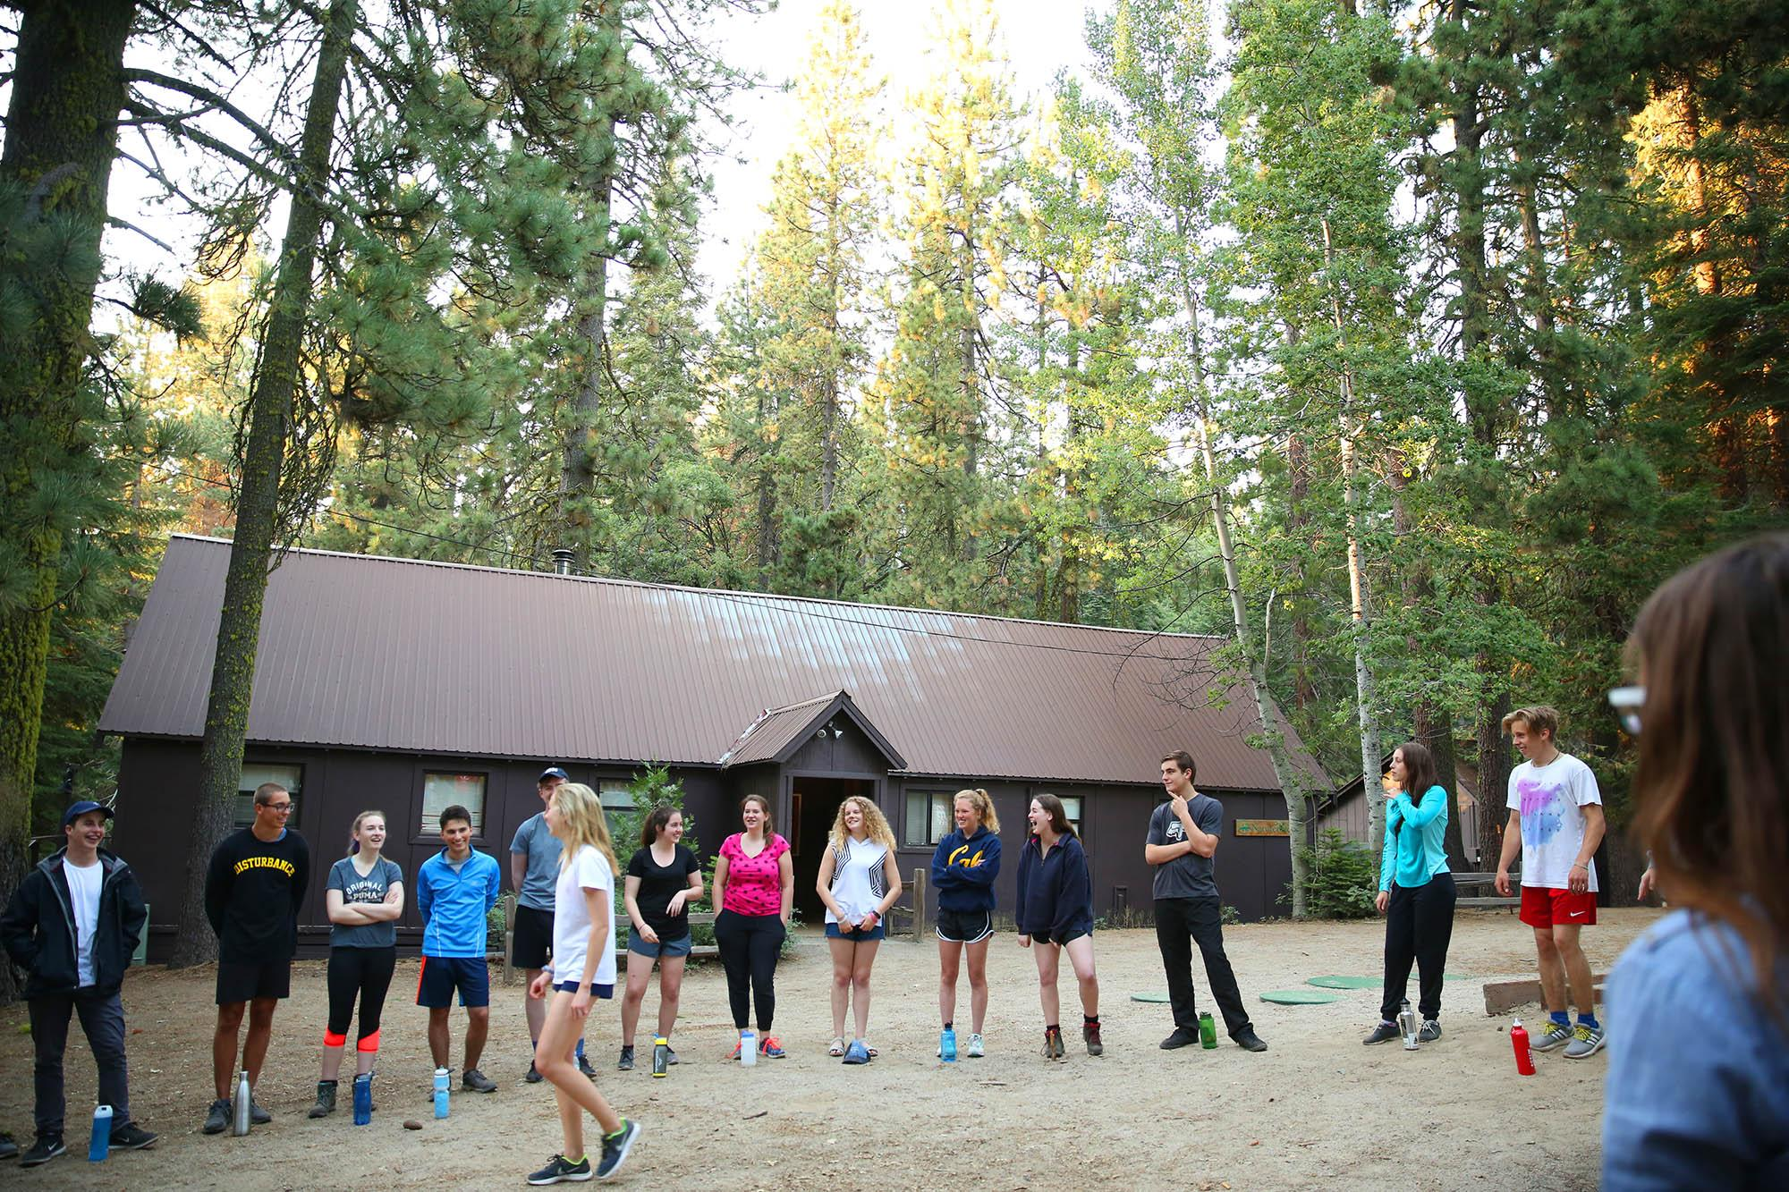
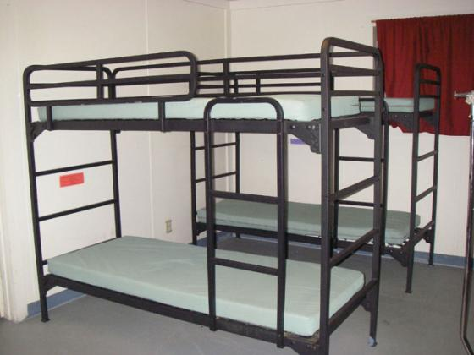
Lodging at Yosemite
Dorm-style bunk house at Crane Flat

Slide 9
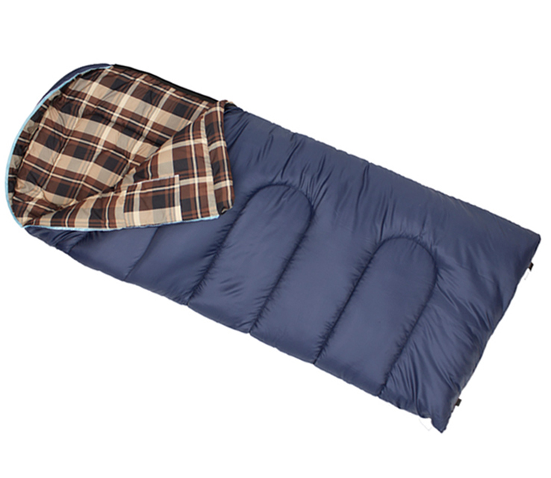
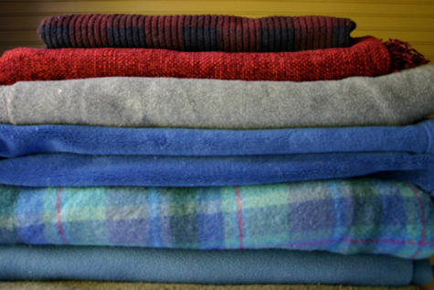
What to Bring: Bedding
Warm Sleeping Bag
or
Warm Blankets and Sheets
(and Pillow for Crane Flat)

Slide 10
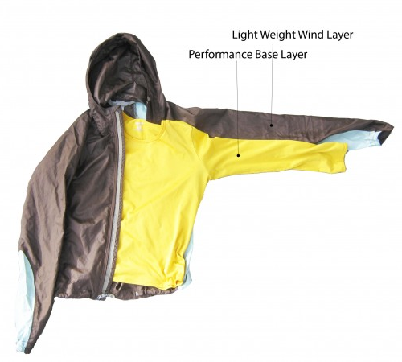
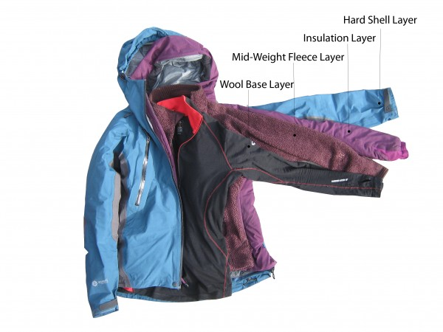
What to Bring: Clothing
Good gear is functional, but doesn’t need to be fancy!
Read the packing list carefully and be prepared for all kinds of weather and for getting dirty.
Rain gear is always required.
For Warm Weather Trips: May-September
For Cold Weather Trips: October-April
Link: Outdoor Gear Lab Layering Systems

Slide 11
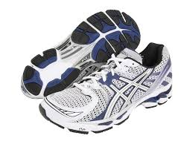
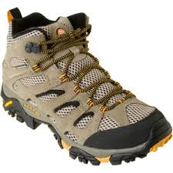
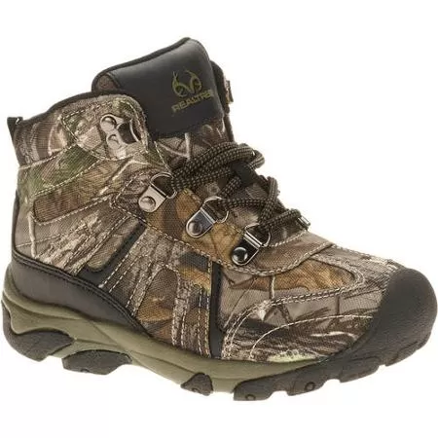
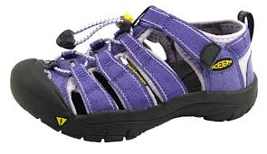
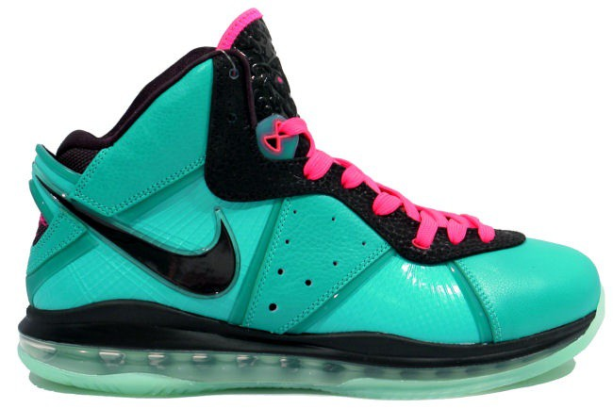
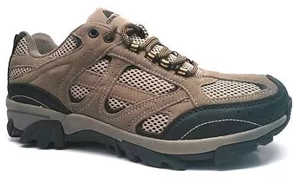
What to Bring: Footwear
Please pack sturdy, broken-in shoes or boots for your trail day
(you can bring extra shoes for around camp).
Yes Waterproof in case of rain or snow. In warmer months, broken in athletic shoes may be worn. | No Not sturdy enough or too nice for hiking in the mud.

Slide 12
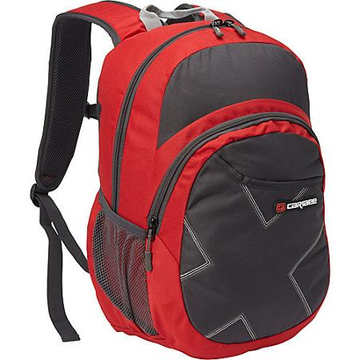
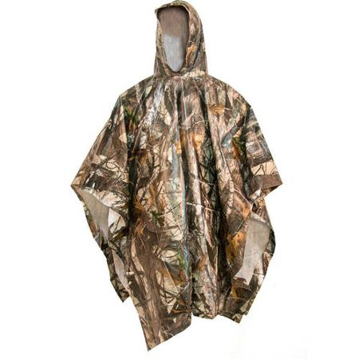
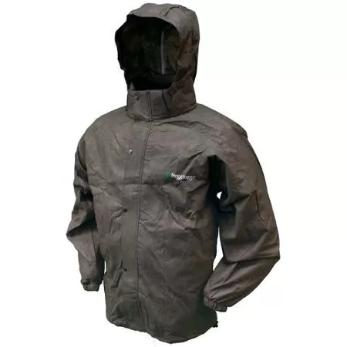
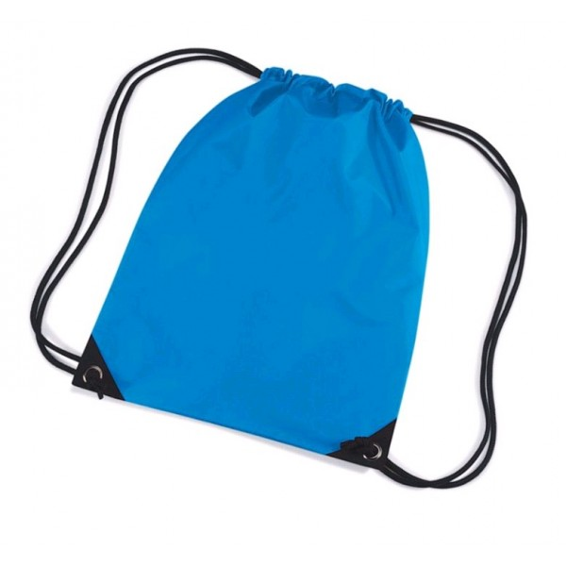
What to Bring: Day Pack
TWO
Liter-sized Water Bottles
No String Bags
Bandanna/ Crumb Catcher for Trail Lunch
Waterproof Top and Bottom or Poncho

Slide 13
Student and Family Agreements
Parents are responsible for picking up their child in Yosemite if they are too ill to hike, injured, or need to be sent home because of a behavior violation.
Behavior is all-important. Students are expected to follow all behavior guidelines. Students have reviewed behavior expectations prior to the trip.
NatureBridge Cell Phone Policy:
Policy [4.16]When student participants are in learning groups with NatureBridge educators and school chaperones, cell phones should be set in airplane mode and used only for taking photos, video or specific school projects. When student participants are not in learning groups, any cell phone use will be supervised by teachers and chaperones. Student participants may not use cell phones in NatureBridge dorms, dining halls, or bathrooms.

Slide 14
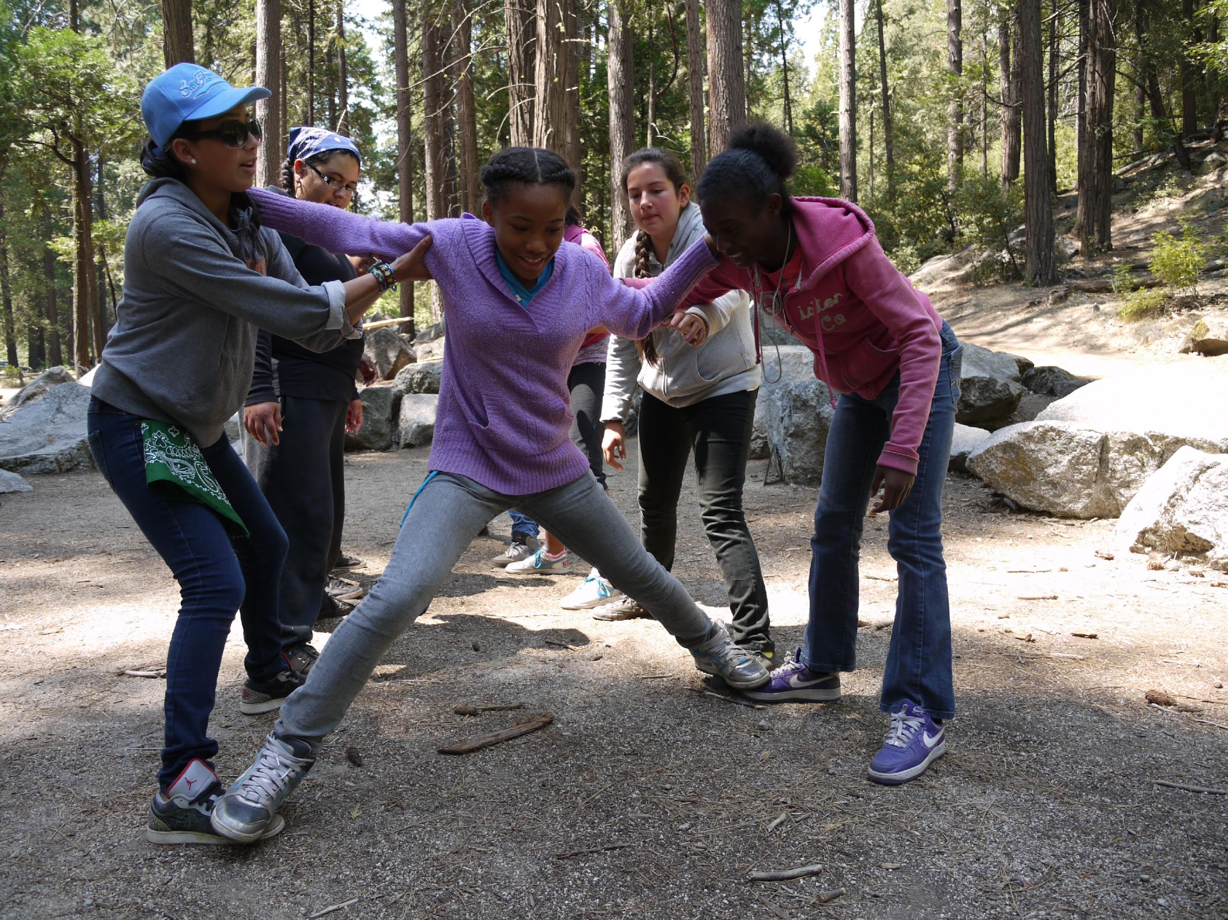
Next Steps
Registration Forms:
Your school’s planning coordinator will email the link to the NatureBridge online registration form.
Modes of Communication:
NatureBridge will be in direct contact with your school’s planning coordinator. Please direct all questions to that individual.
Timeline and Calendar:
Please adhere to all deadlines dictated by your school’s planning coordinator. This ensures that NatureBridge can provide the safest/highest quality program for your student.
Contact Person:
(Insert name of school planning coordinator)

